Slide 1
Girls day celebration 11/10/2024
CHIEF EXECUTIVE OFFFICER DISTRICT CHINIOT

Slide 2
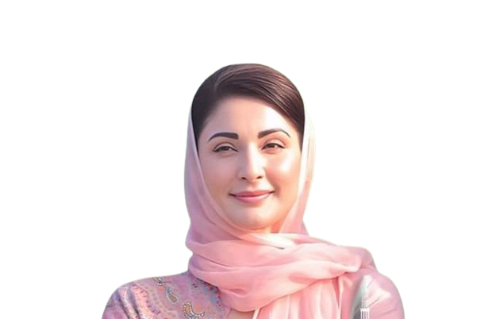
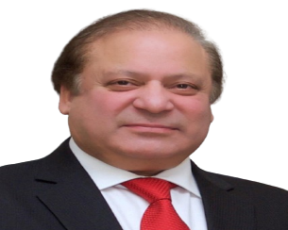
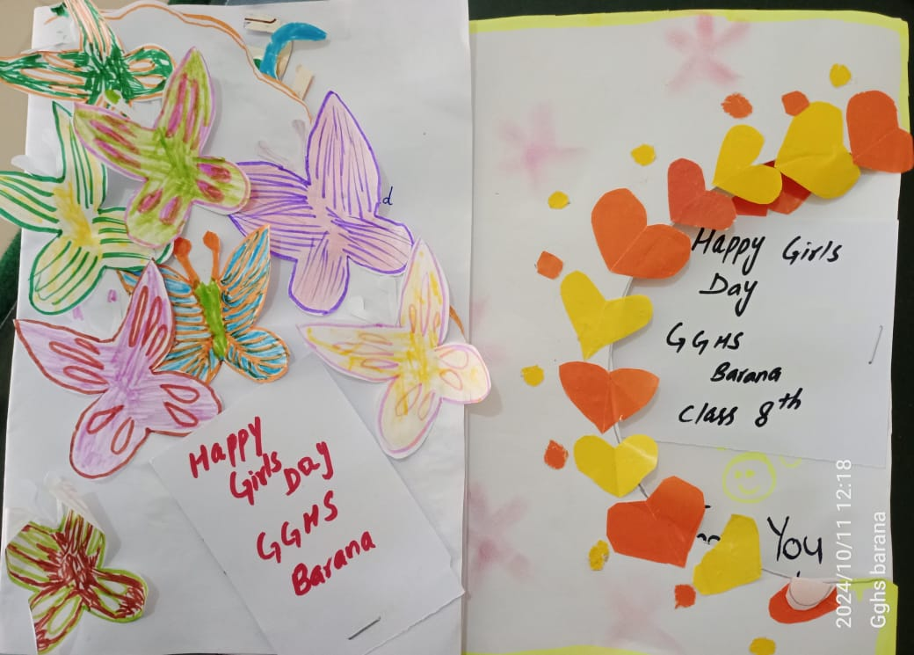
“Girls Day” Celebration
GGHS Brana

Slide 3
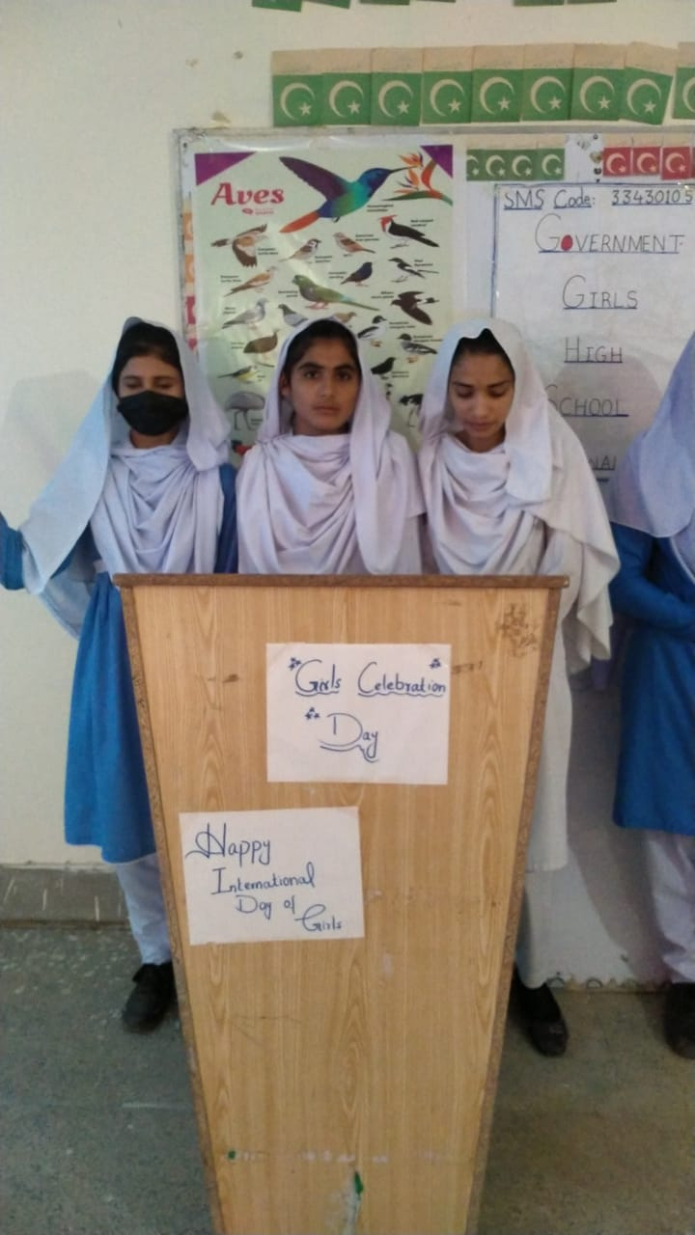
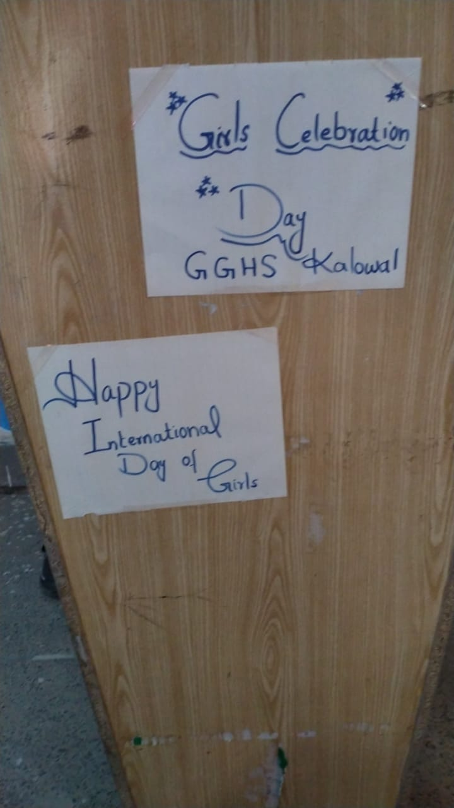
“Girls Day” Celebration
GGHS Kalowal

Slide 4
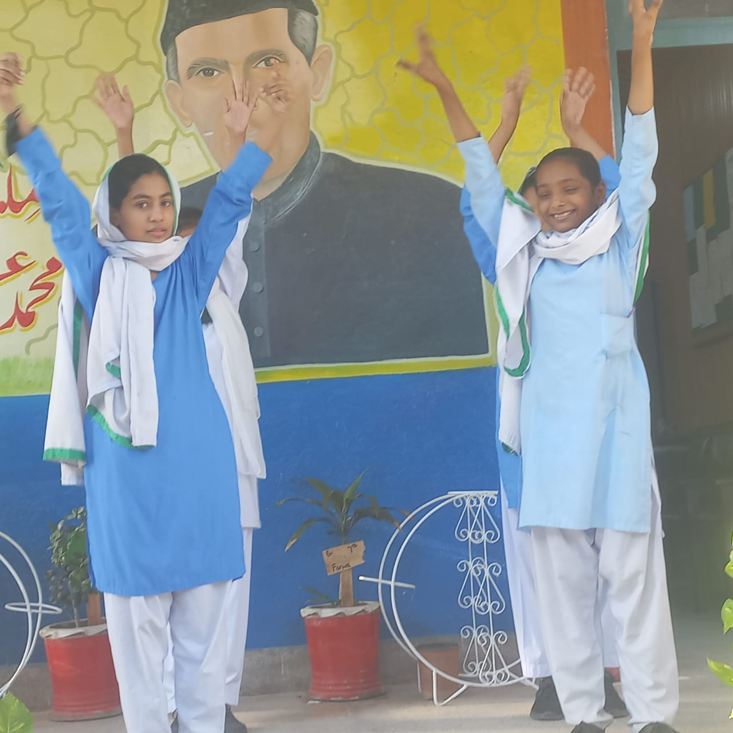
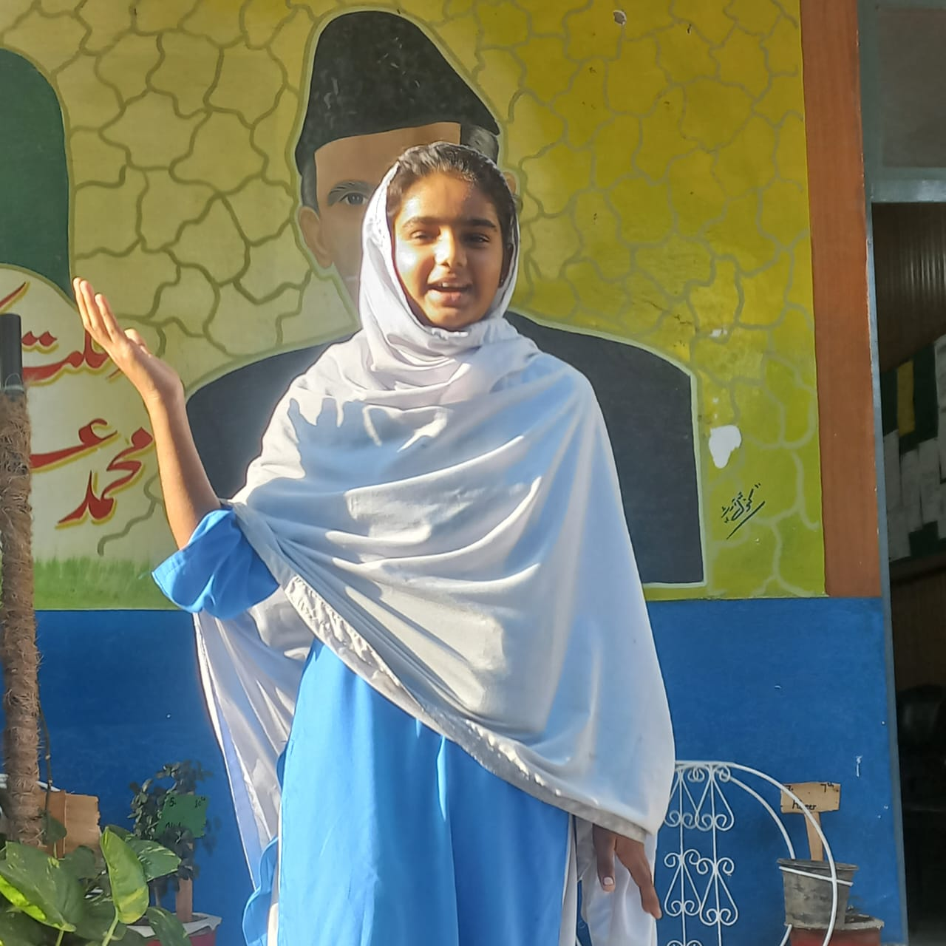
“Girls Day” Celebration
GGHS Ahmad Nager

Slide 5
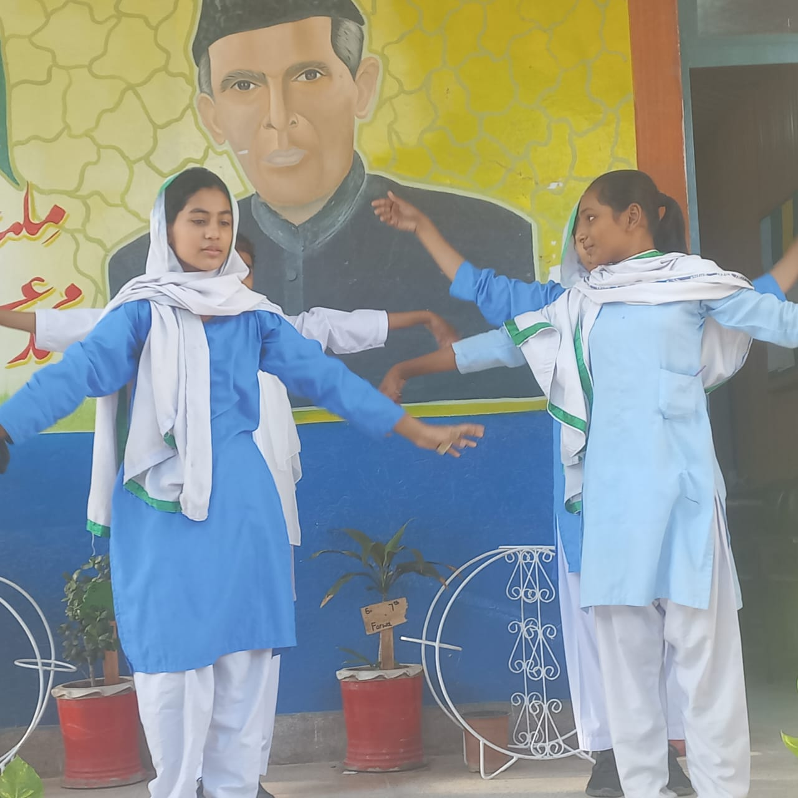
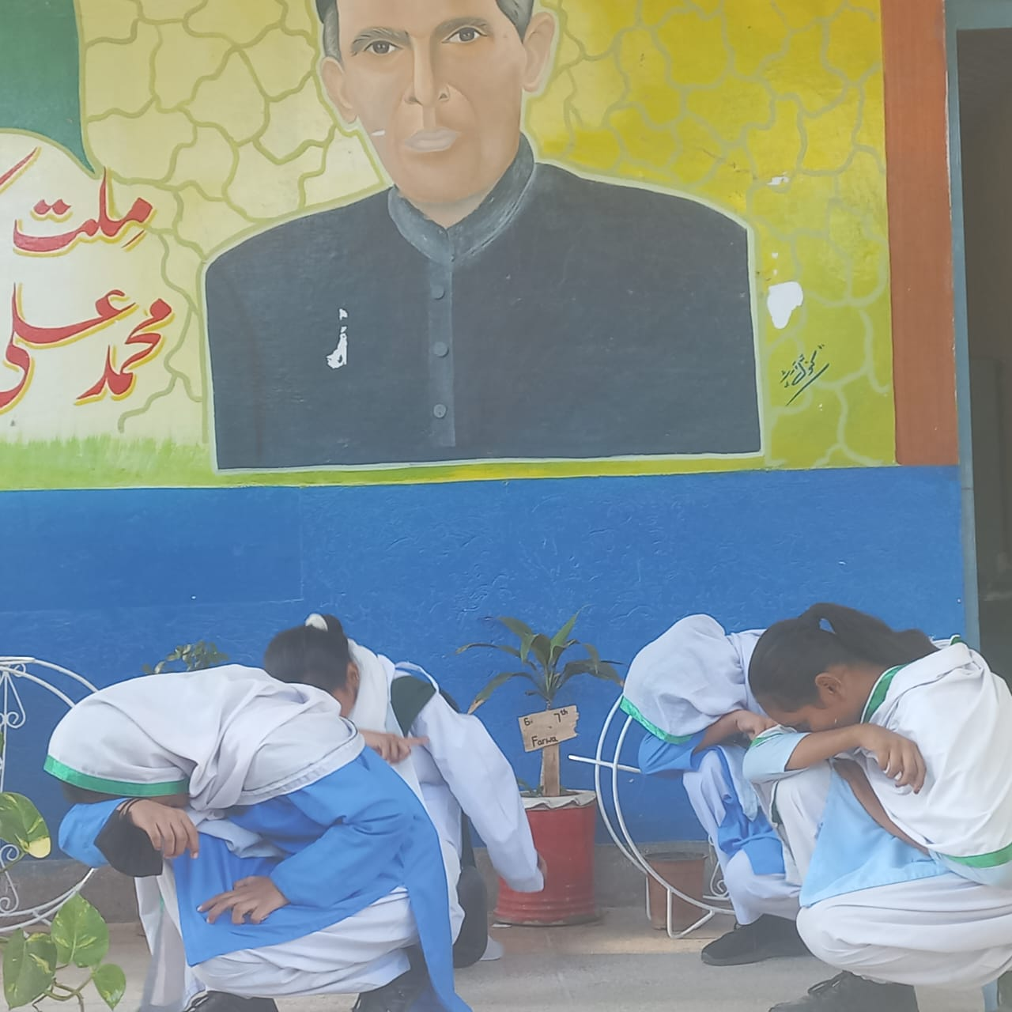
“Girls Day” Celebration
GGHS Ahmad Nagar

Slide 6
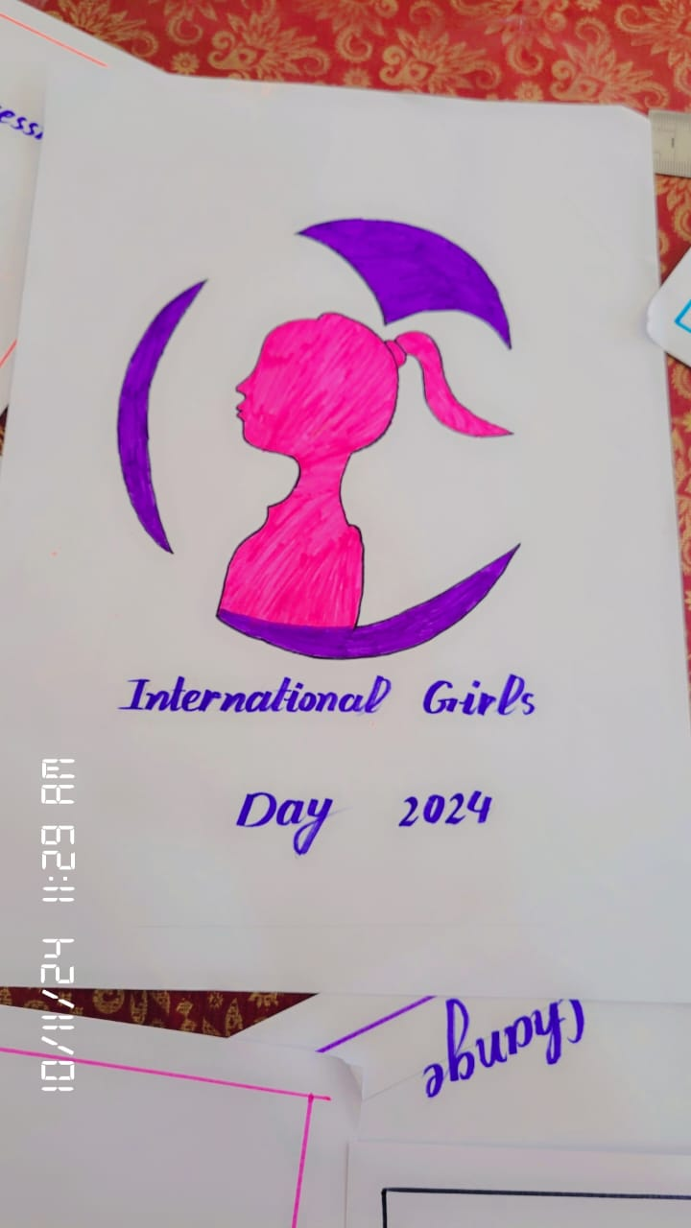
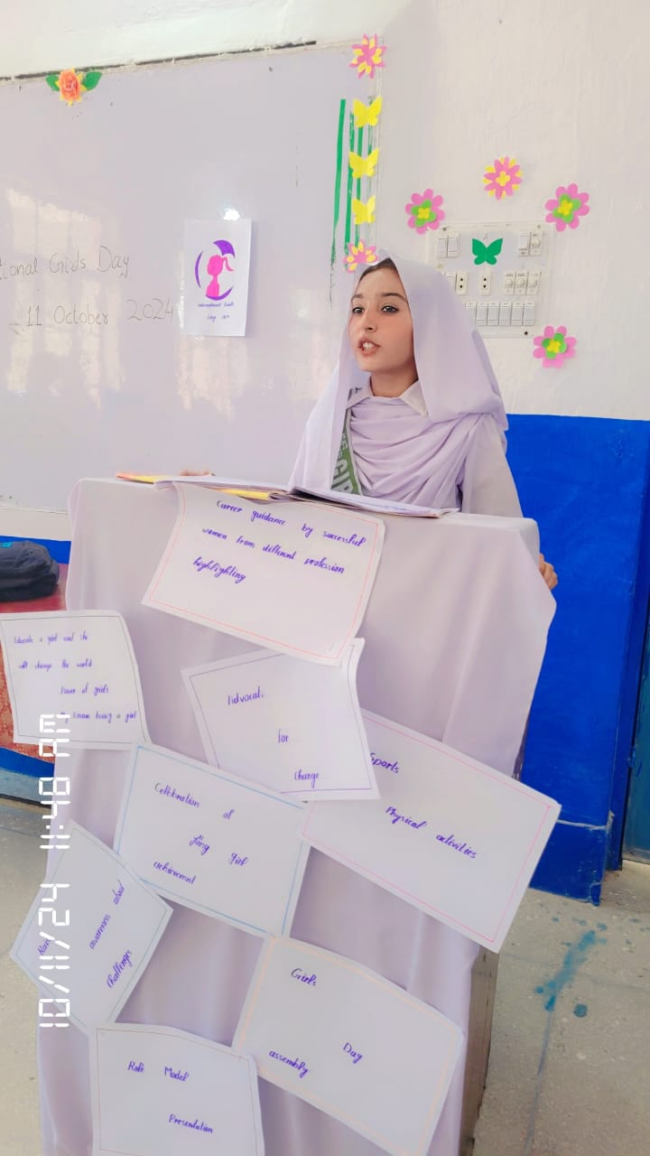
“Girls Day” Celebration
GGHS Chak #25 Jb

Slide 7
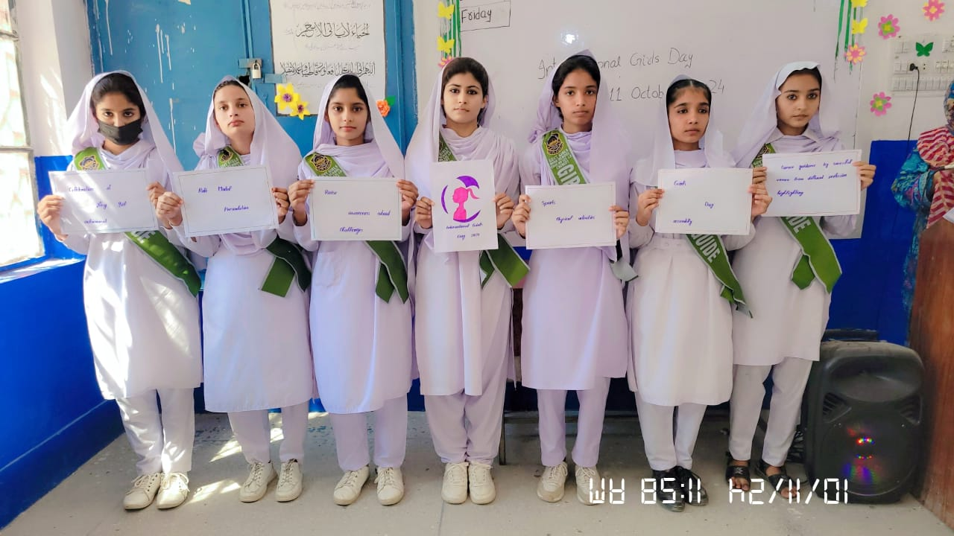
“Girls Day” Celebration
GGHS Chak #25 Jb

Slide 8
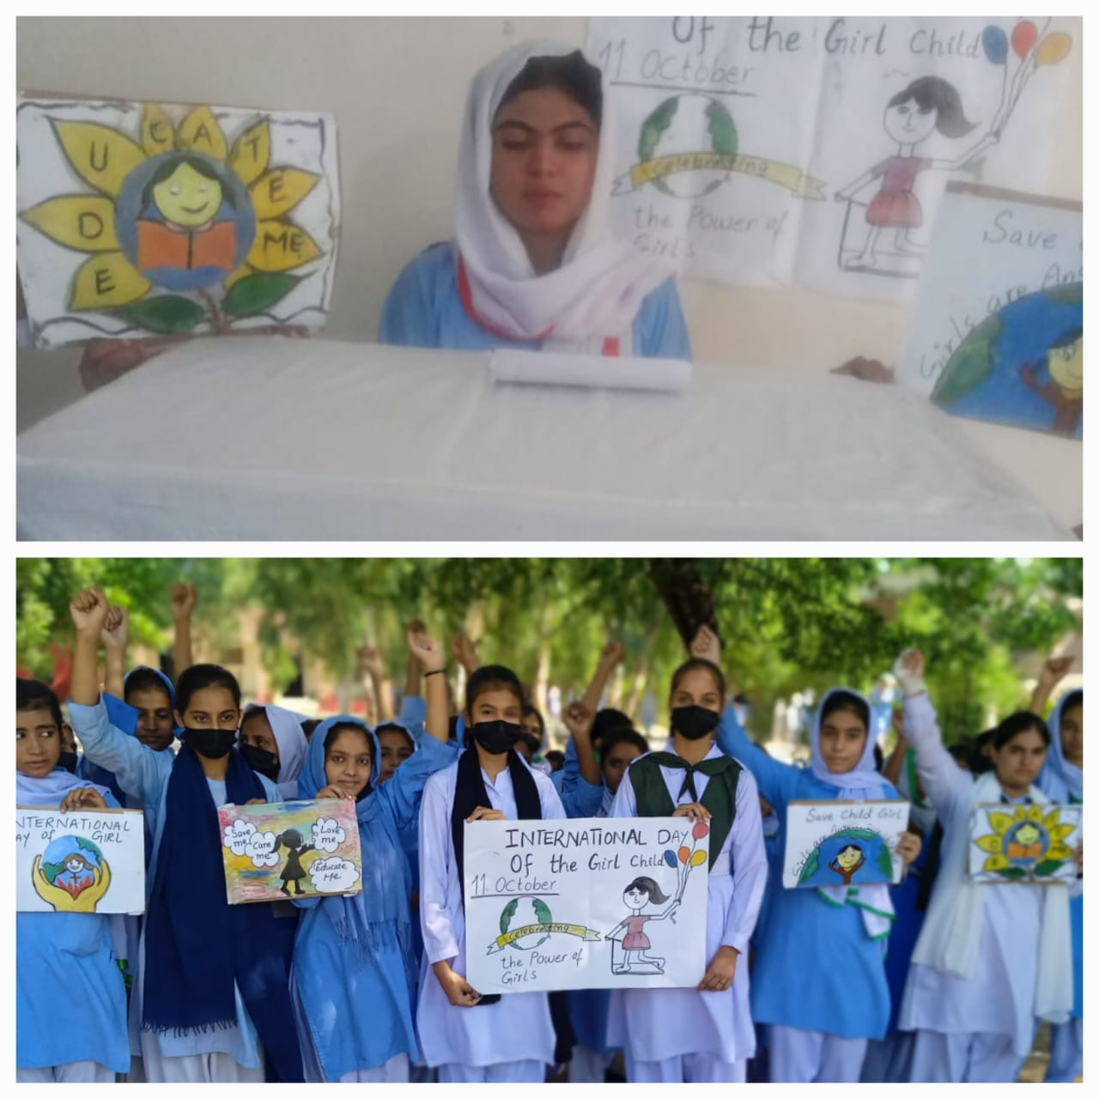
“Girls Day” Celebration
Govt.Nusrat Girls H/S Chenab Nagar

Slide 9
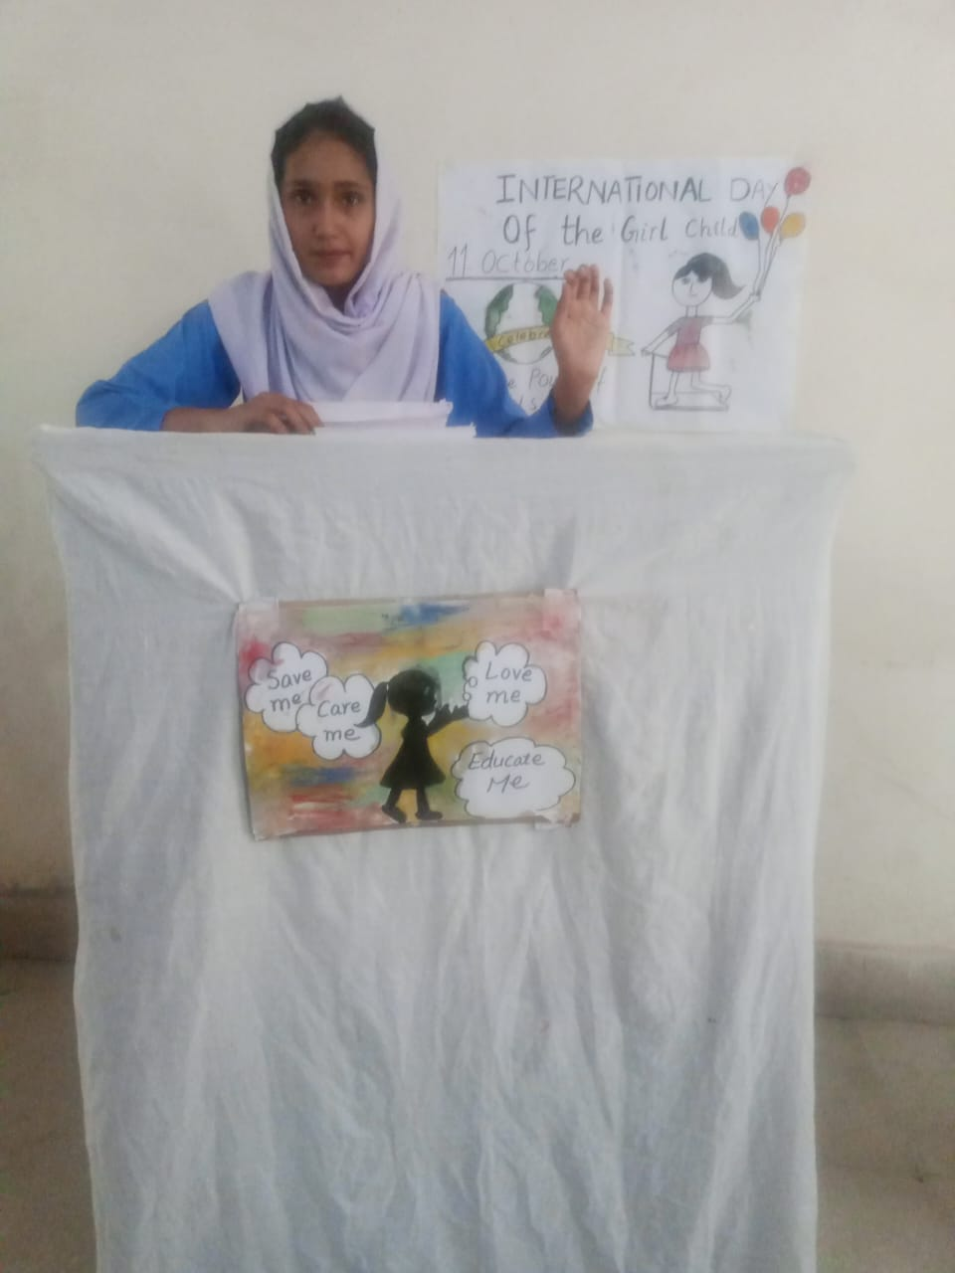
“Girls Day” Celebration
Govt.Nusrat Girls H/S Chenab Nagar

Slide 10
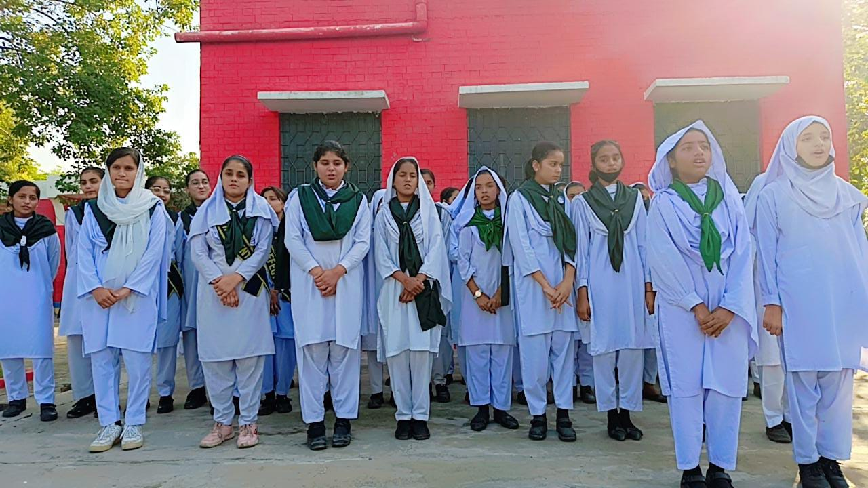
“Girls Day” Celebration
GGHS Sattelite Town Chiniot

Slide 11
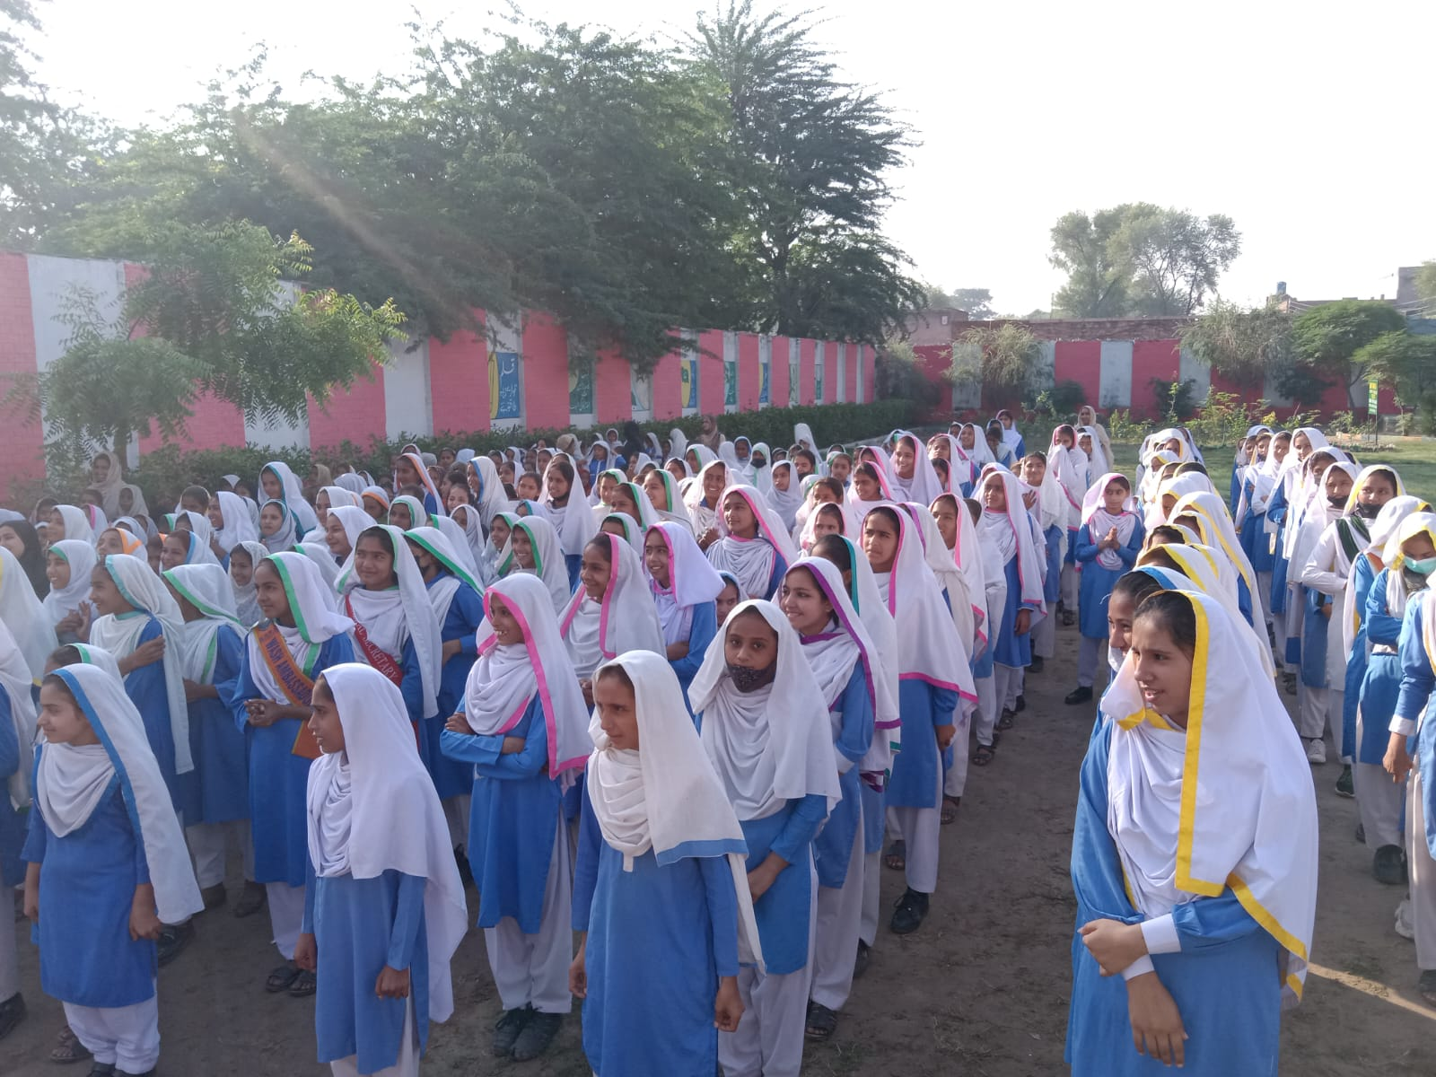
“Girls Day” Celebration
GGHS Thatti Bala Raja

Slide 12
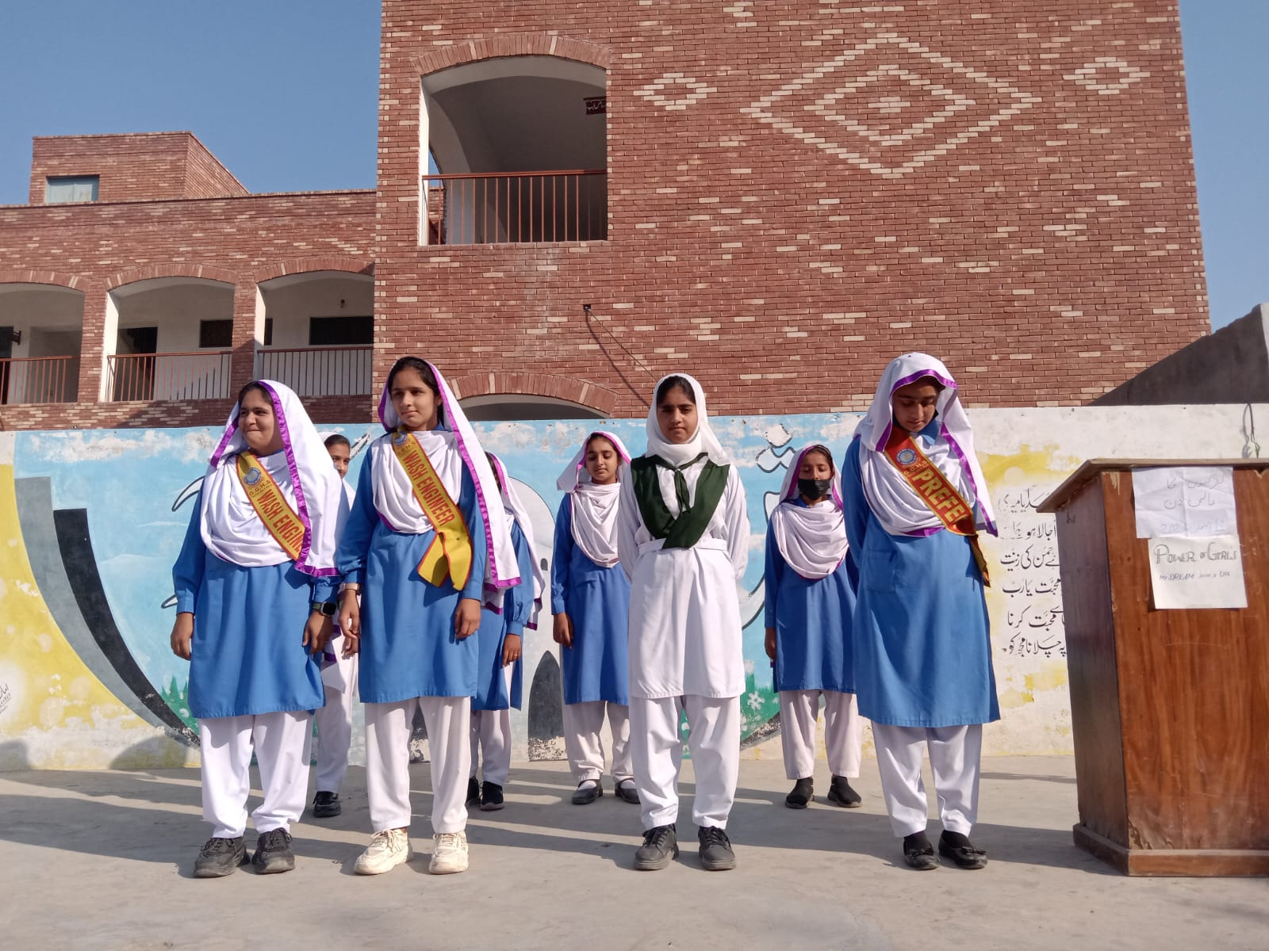
“Girls Day” Celebration
GGHS Kandiwal

Slide 13
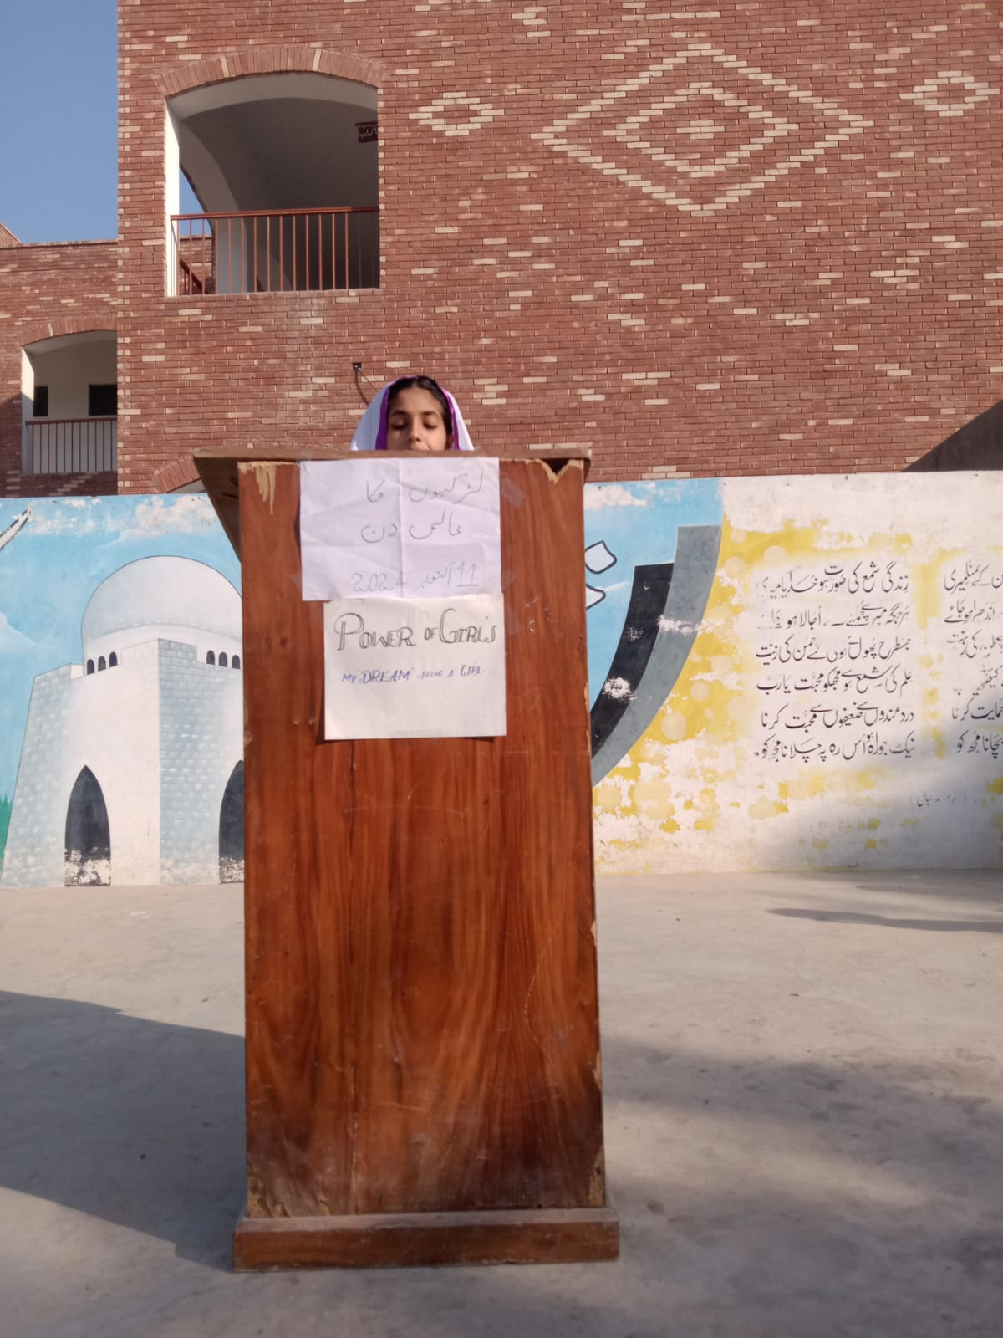
“Girls Day” Celebration
GGHSS Lalian

Slide 14
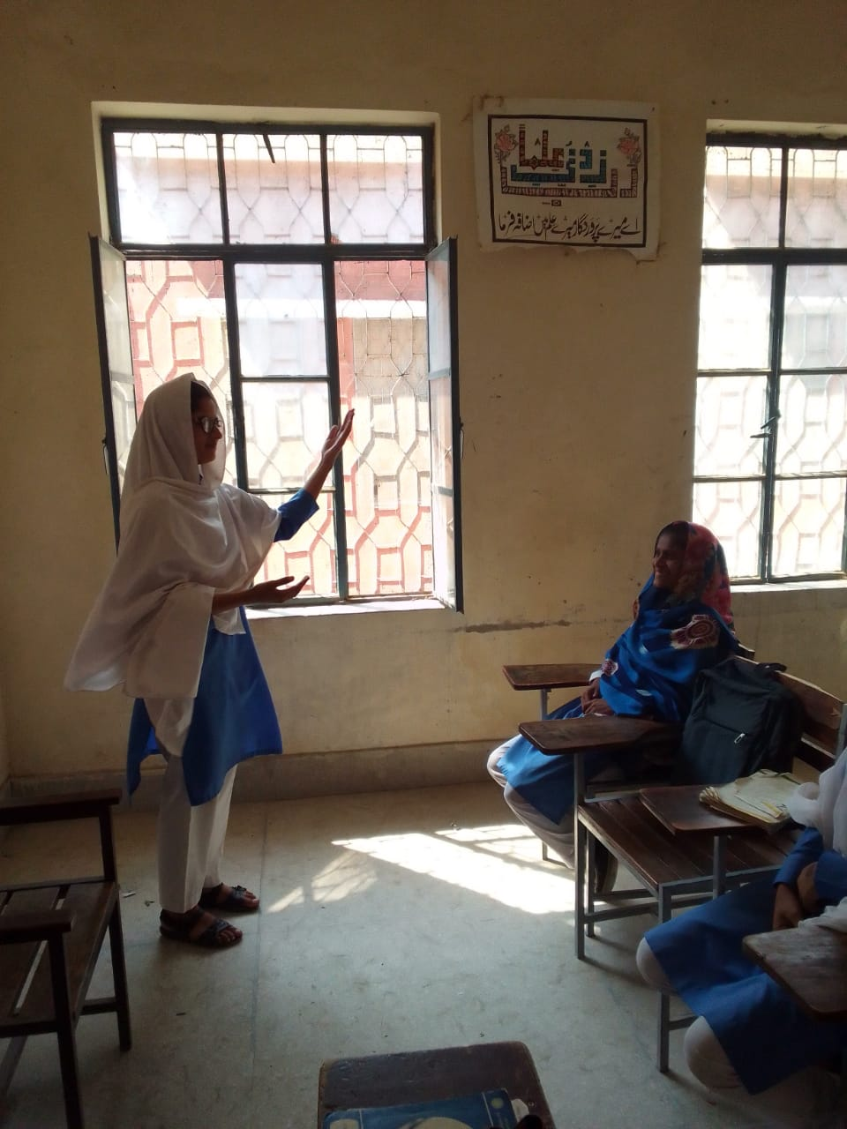
“Girls Day” Celebration 11/10/2024
GGHS Rao Bagh Chiniot

Slide 15
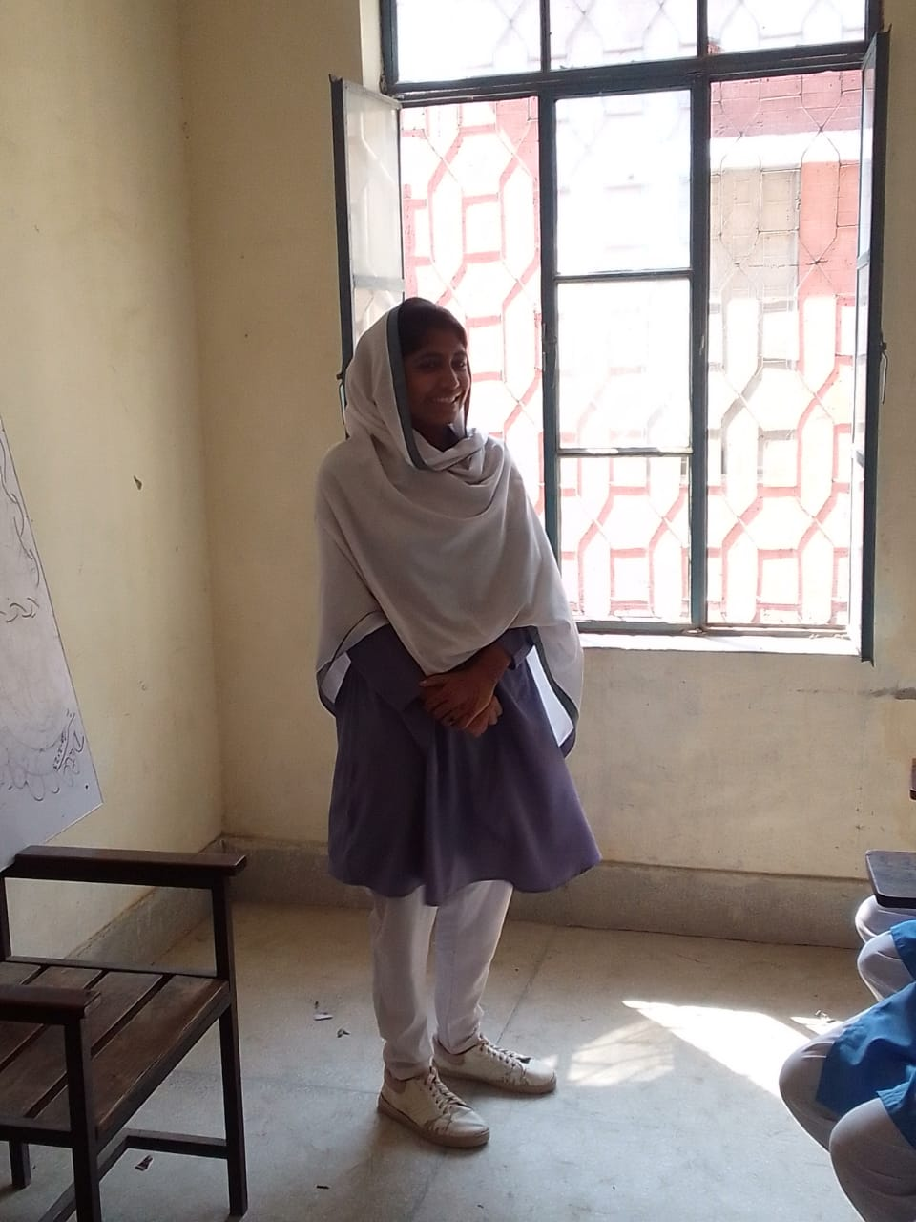
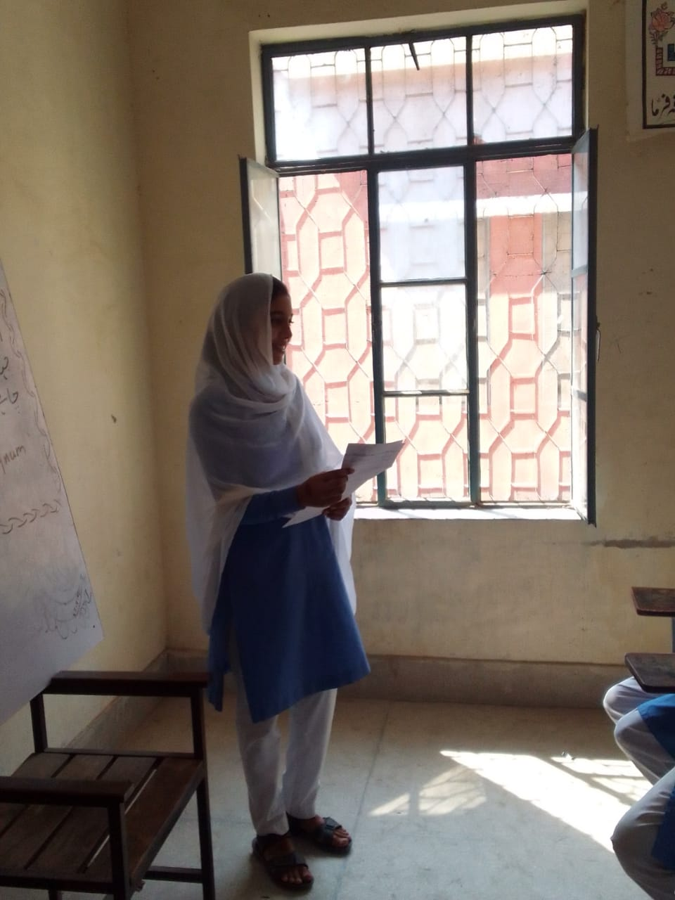
“Girls Day” Celebration 11/10/2024
GGHS Chak # 203 Jb

Slide 16
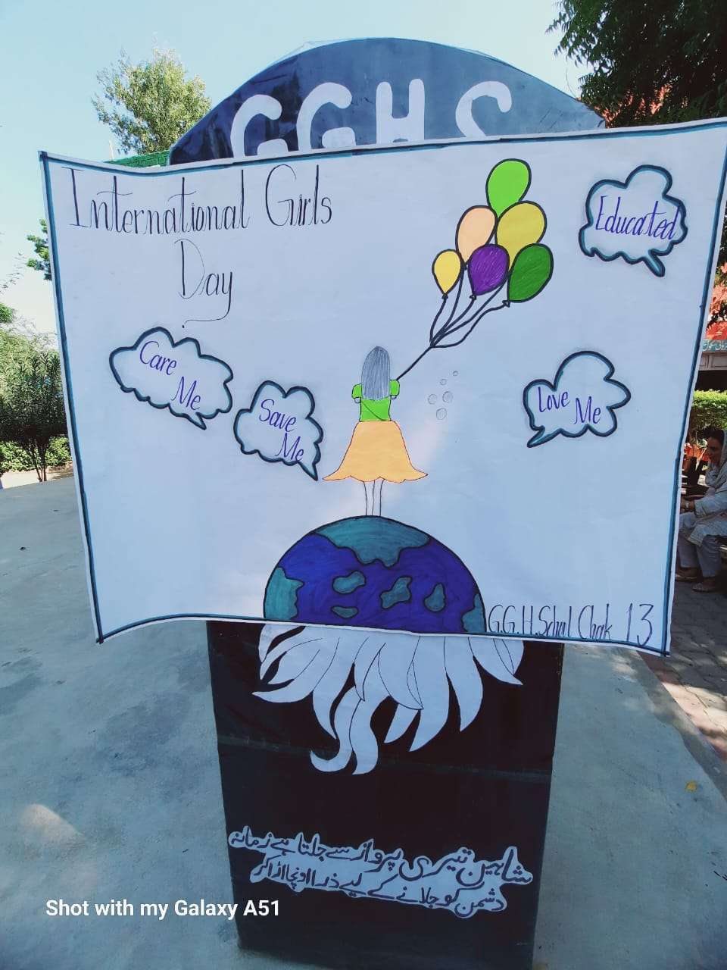
“Girls Day” Celebration 11/10/2024
GGHS Chak # 13 Jb

Slide 17
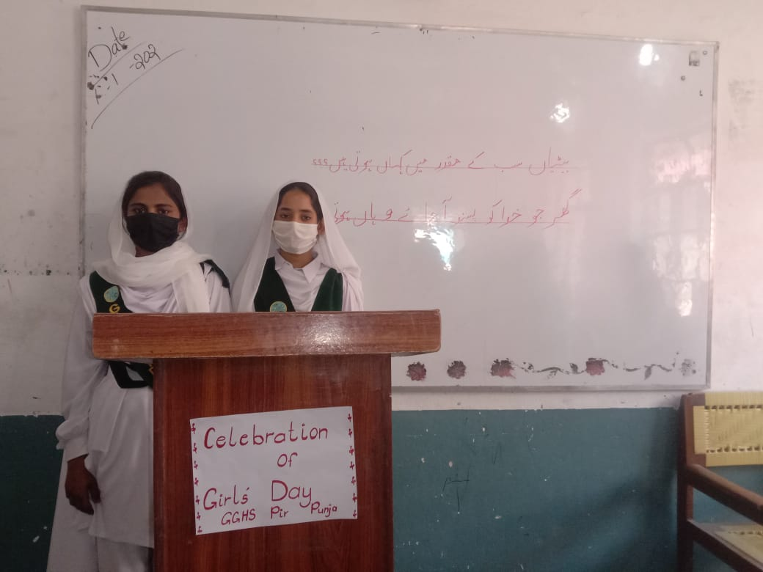
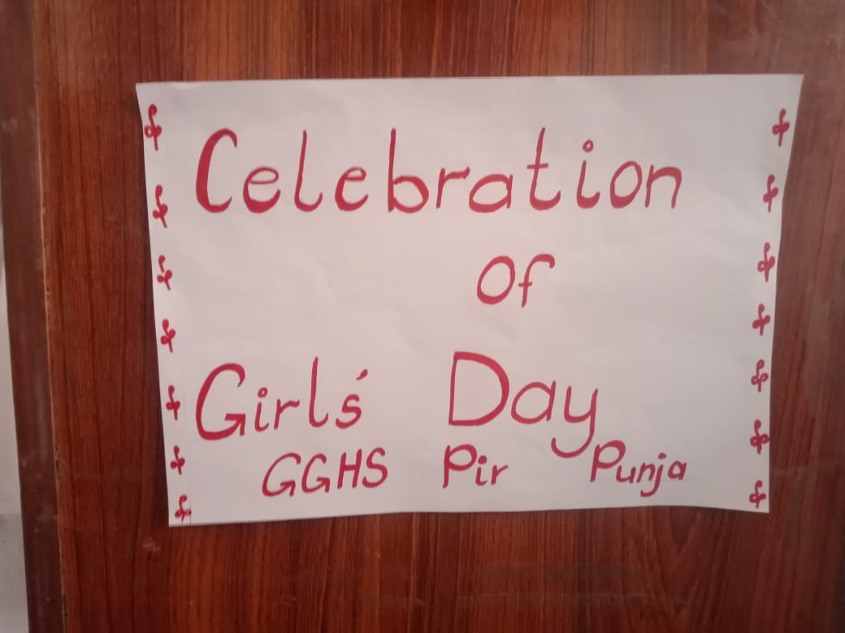
“Girls Day” Celebration 11/10/2024
GGHS Pir Punja

Slide 18
“Girls Day” Celebration 11/10/2024
GGHS Barana

Slide 19
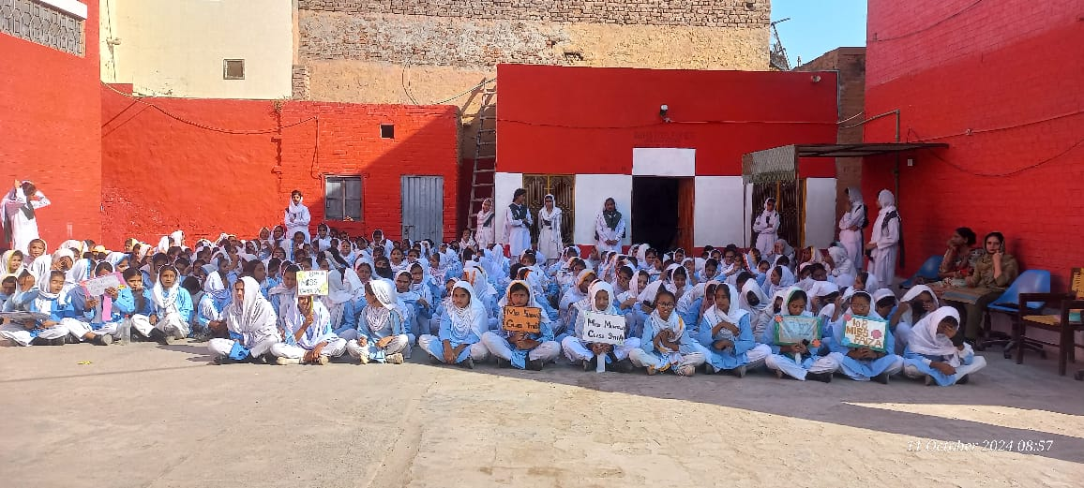
“Girls Day” Celebration 11/10/2024
GGHS Fazal-E-Omar Chenab Nagar

Slide 20
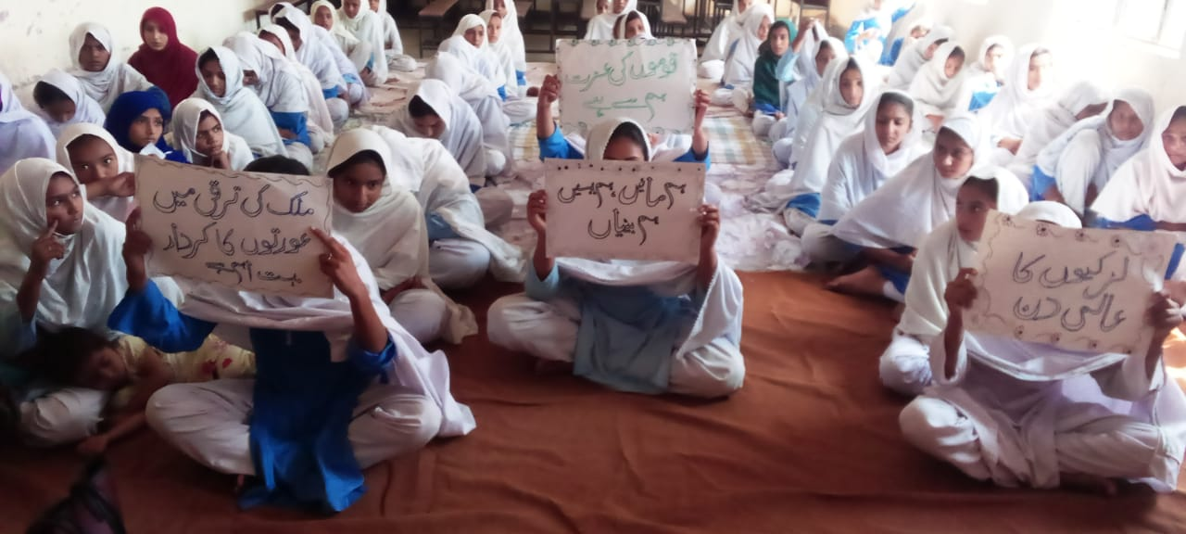
“Girls Day” Celebration 11/10/2024
GGHS Chak #134 Jb

Slide 21
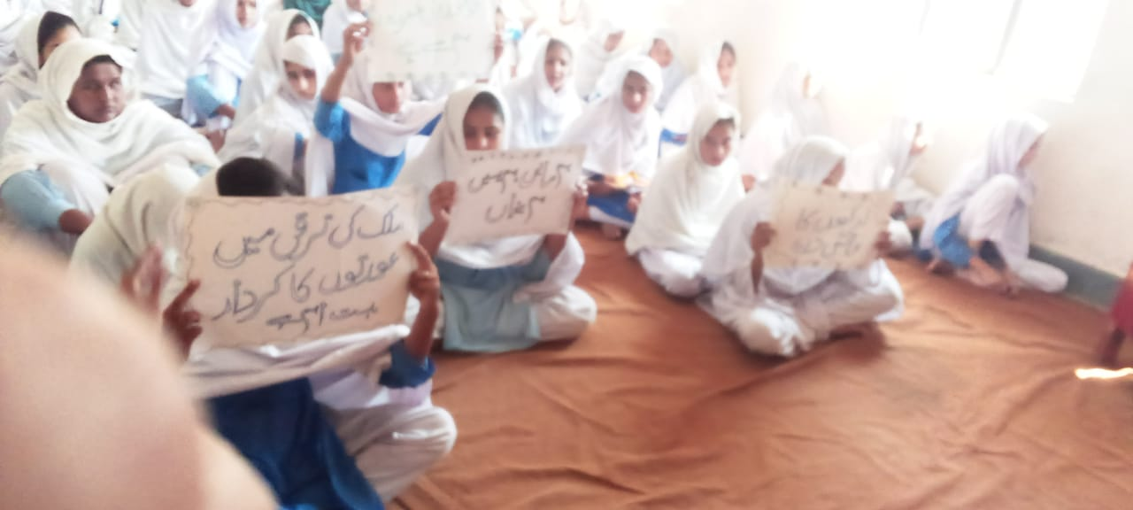
“Girls Day” Celebration 11/10/2024
GGHS Chak #134 Jb

Slide 22
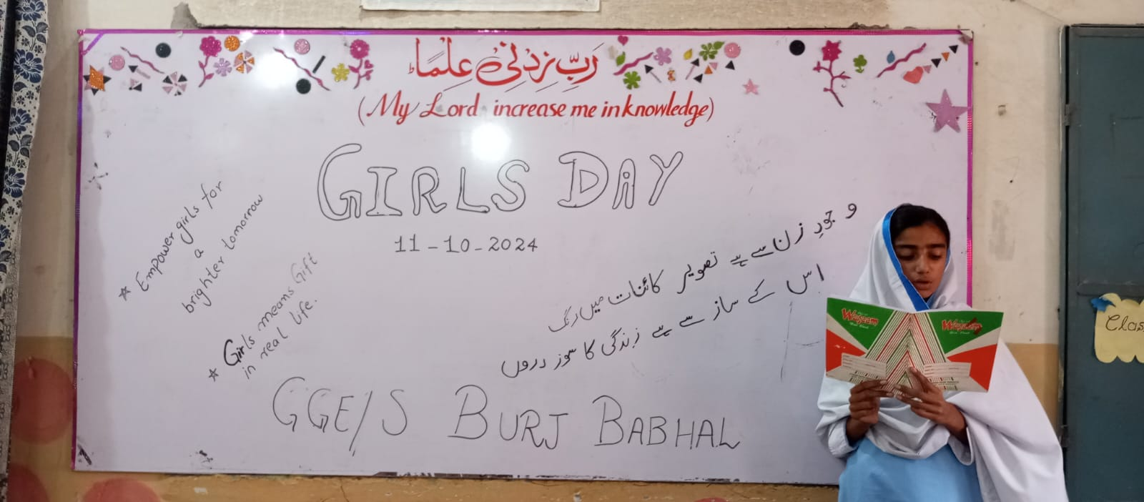
“Girls Day” Celebration
GGES Burj Babhal

Slide 23
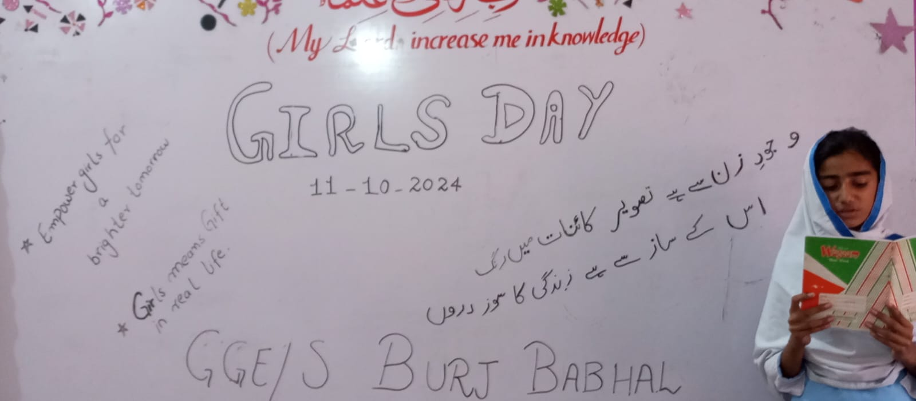
“Girls Day” Celebration
GGES Burj Babhal

Slide 24
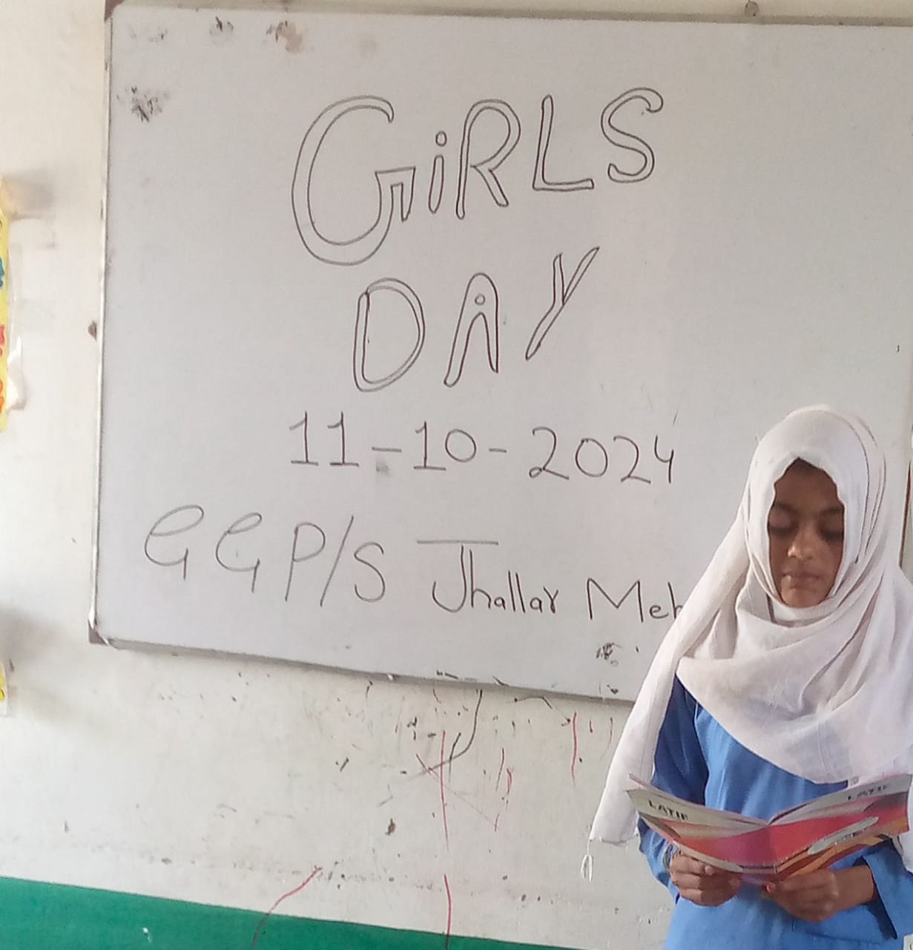
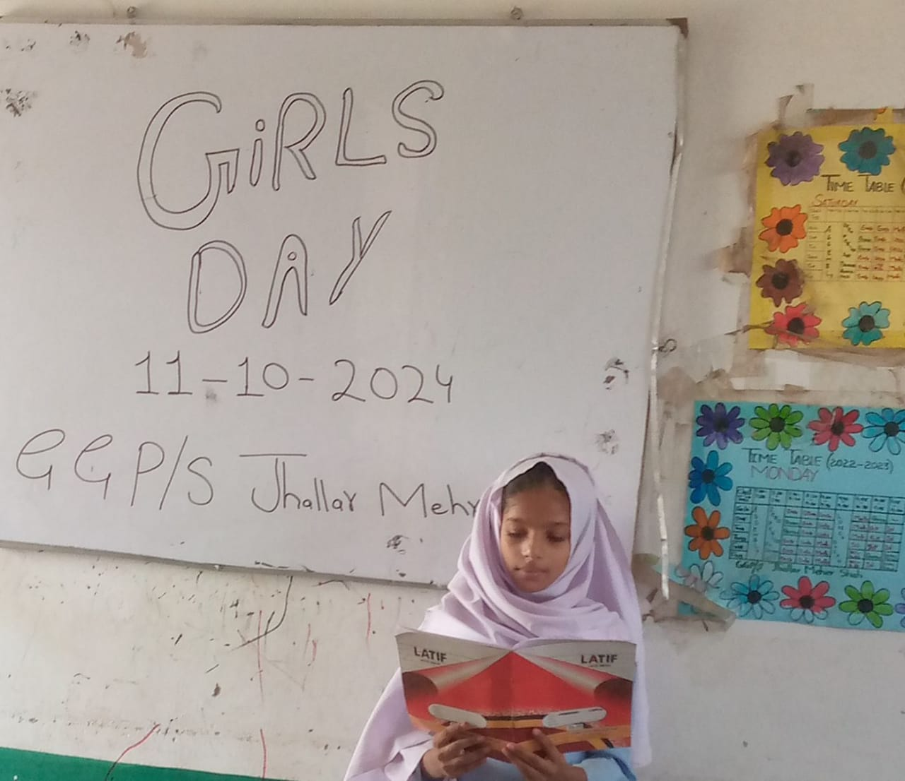
“Girls Day” Celebration
GGPS Jhalar Mahr

Slide 25
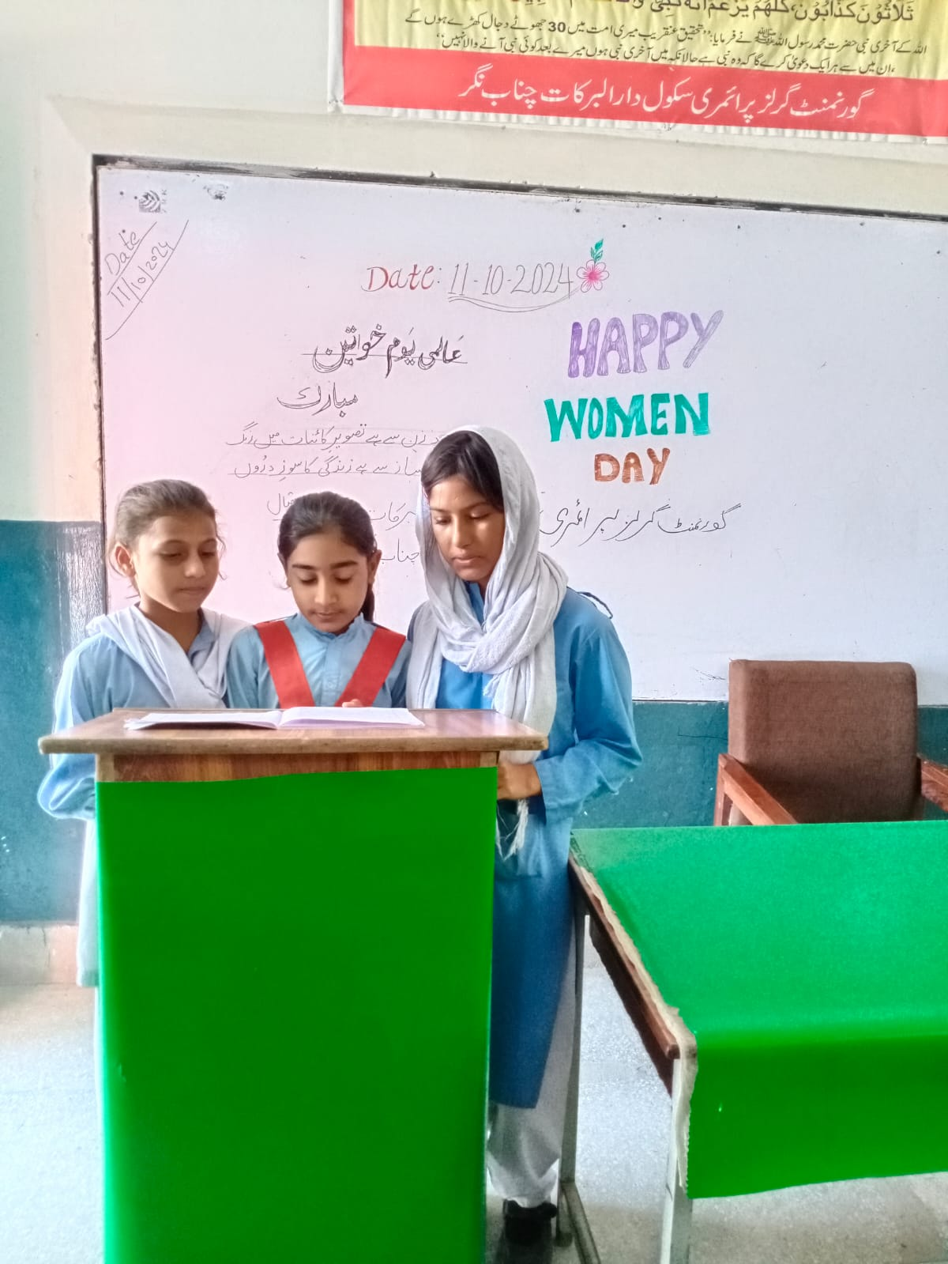
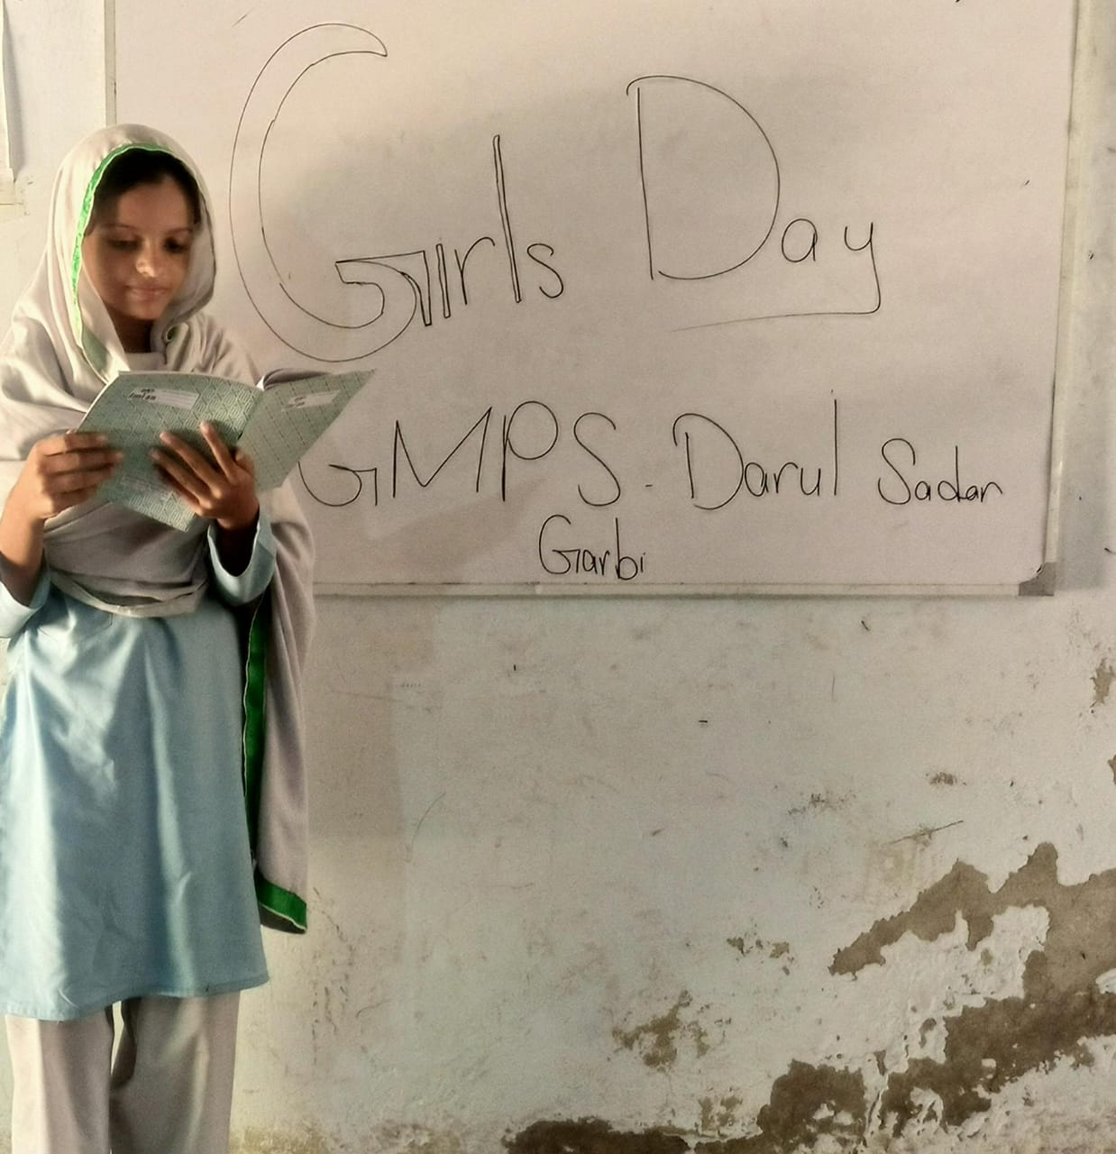
“Girls Day” Celebration Lalian

Slide 26
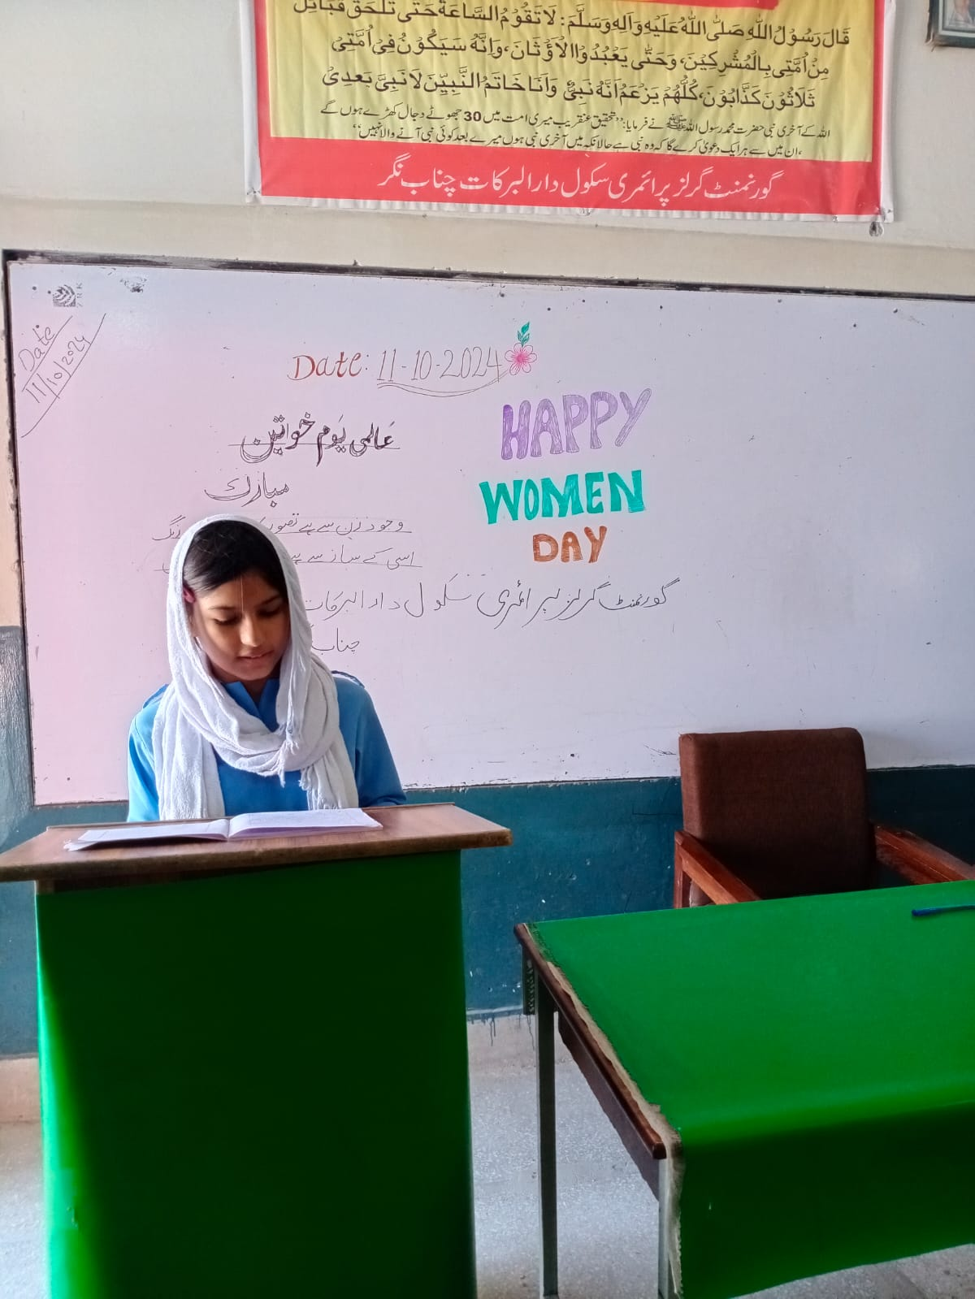
“Girls Day” Celebration Lalian

Slide 27
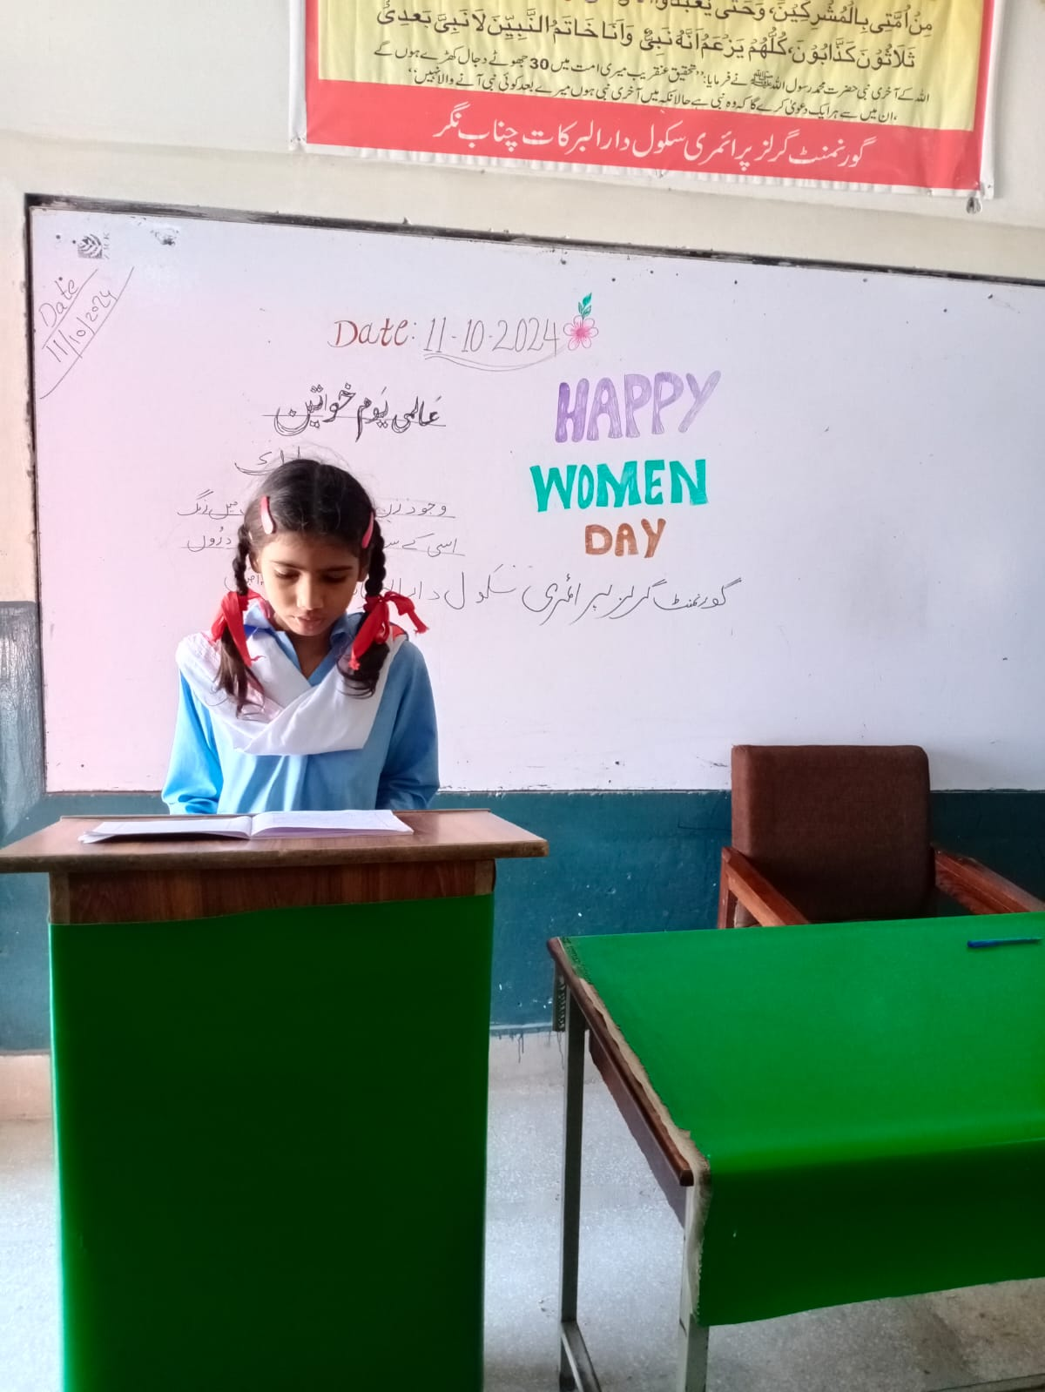
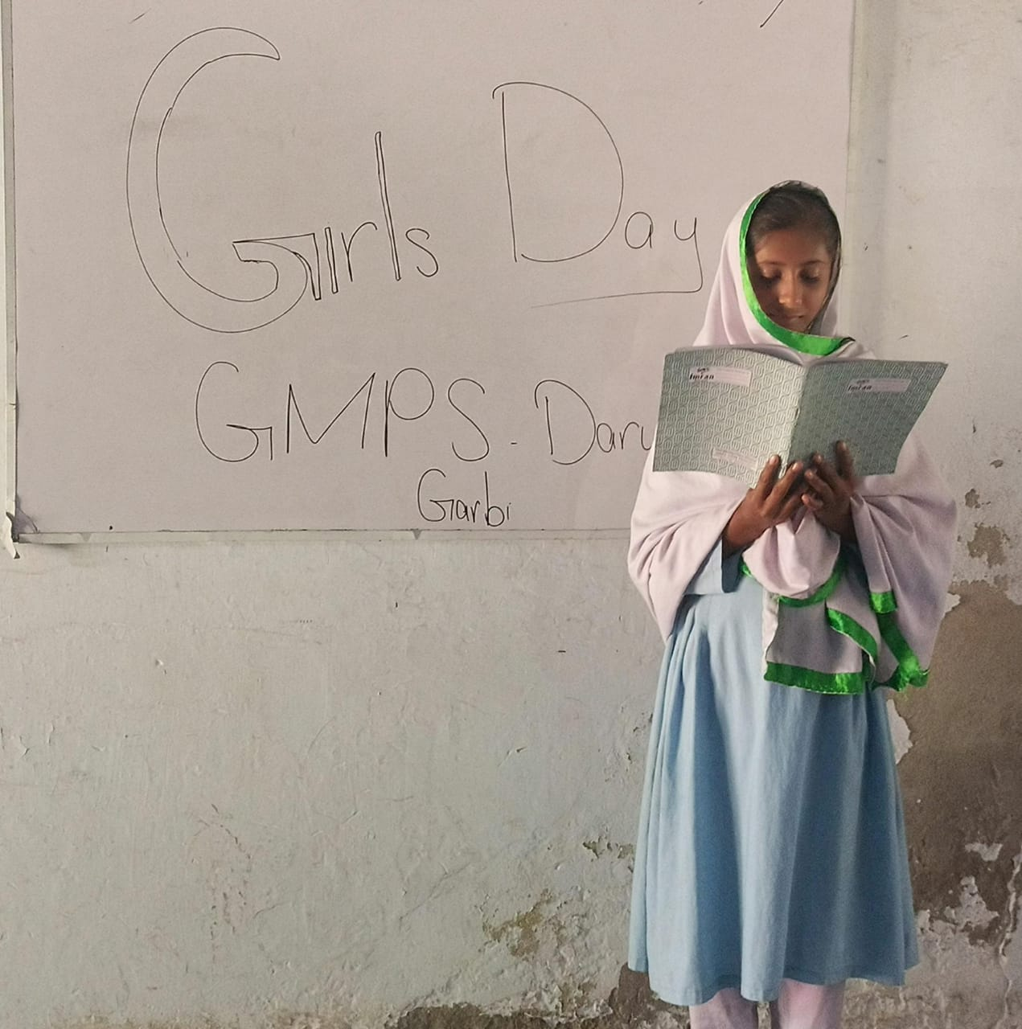
“Girls Day” Celebration Lalian

Slide 28
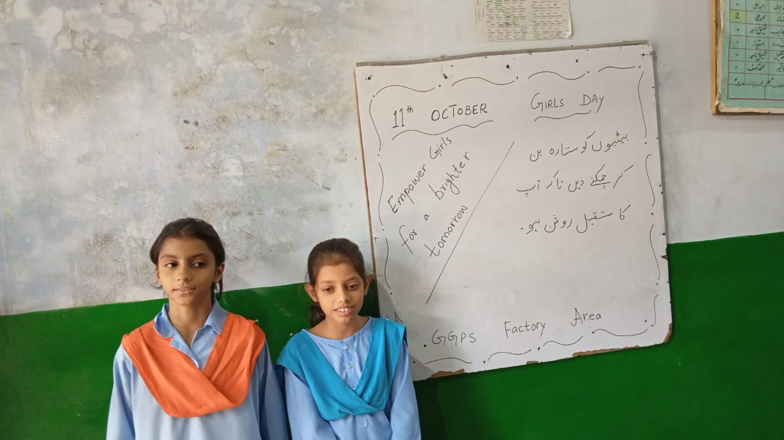
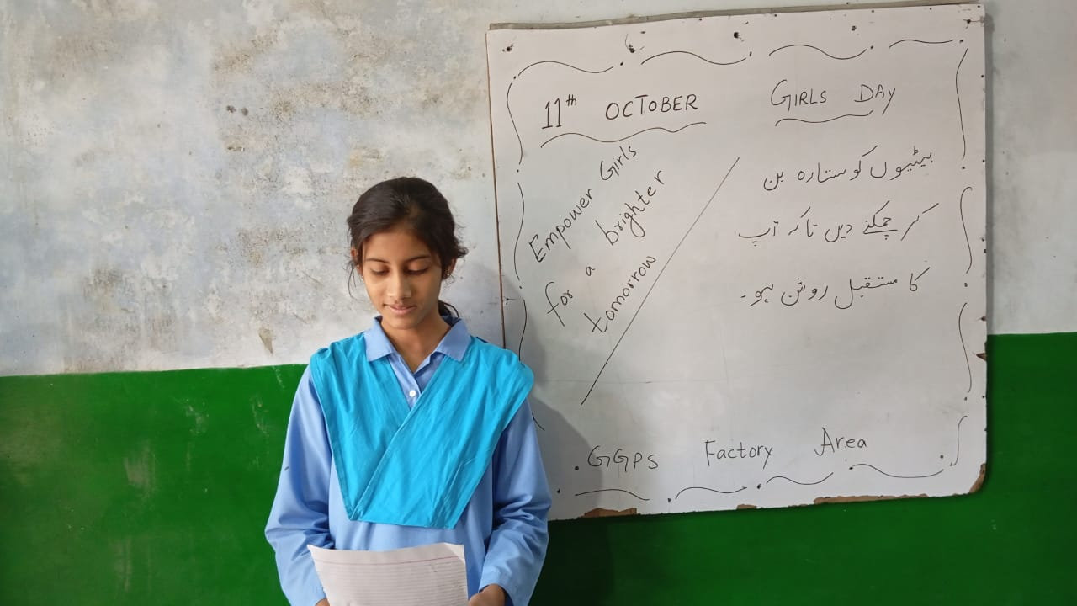
“Girls Day” Celebration Lalian

Slide 29
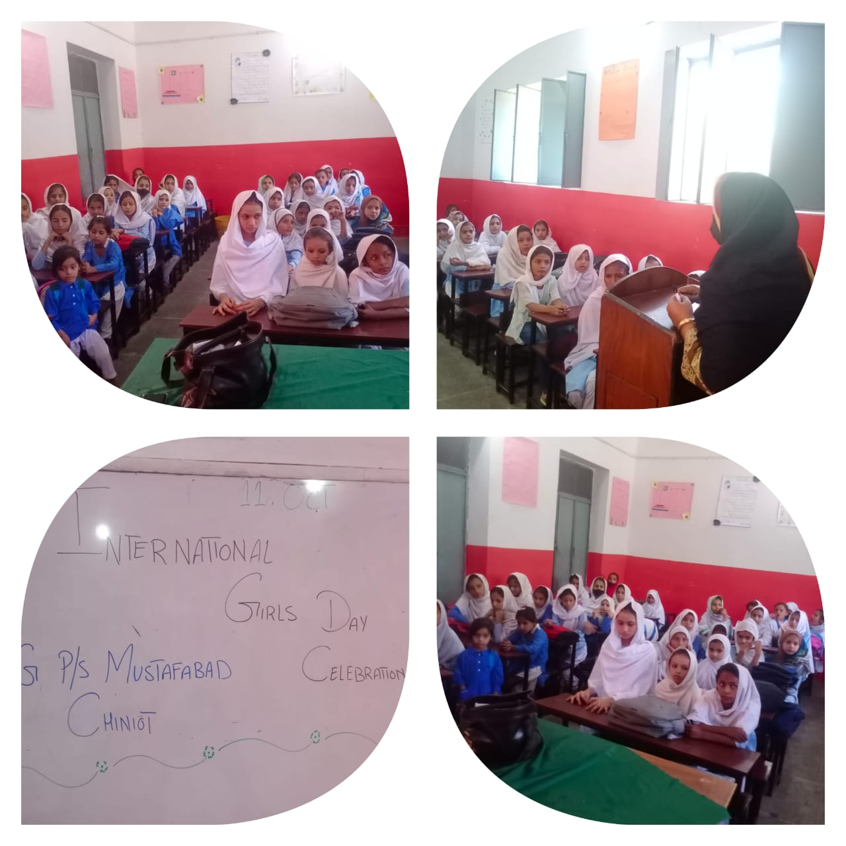
“Girls World Day Celebration Chiniot

Slide 30
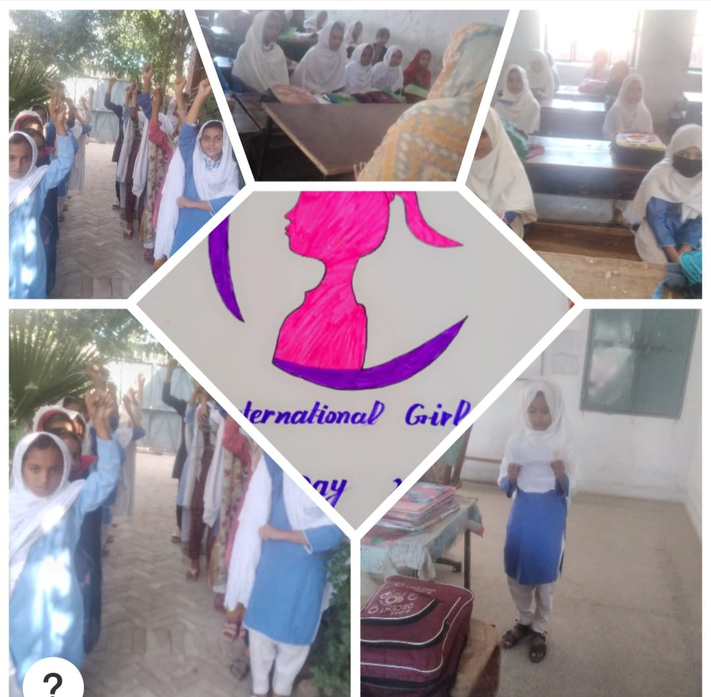
“Girls World Day Celebration Cermony Chiniot

Slide 31
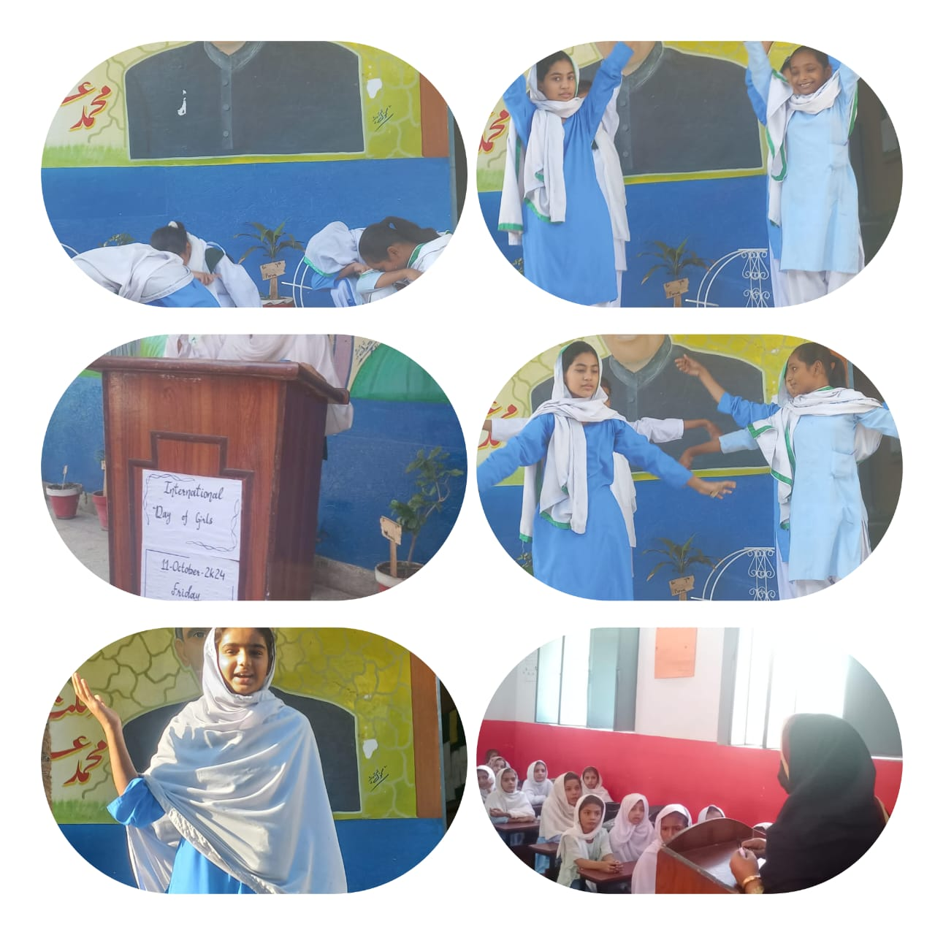
Girls World Day Celebration Chiniot

Slide 32
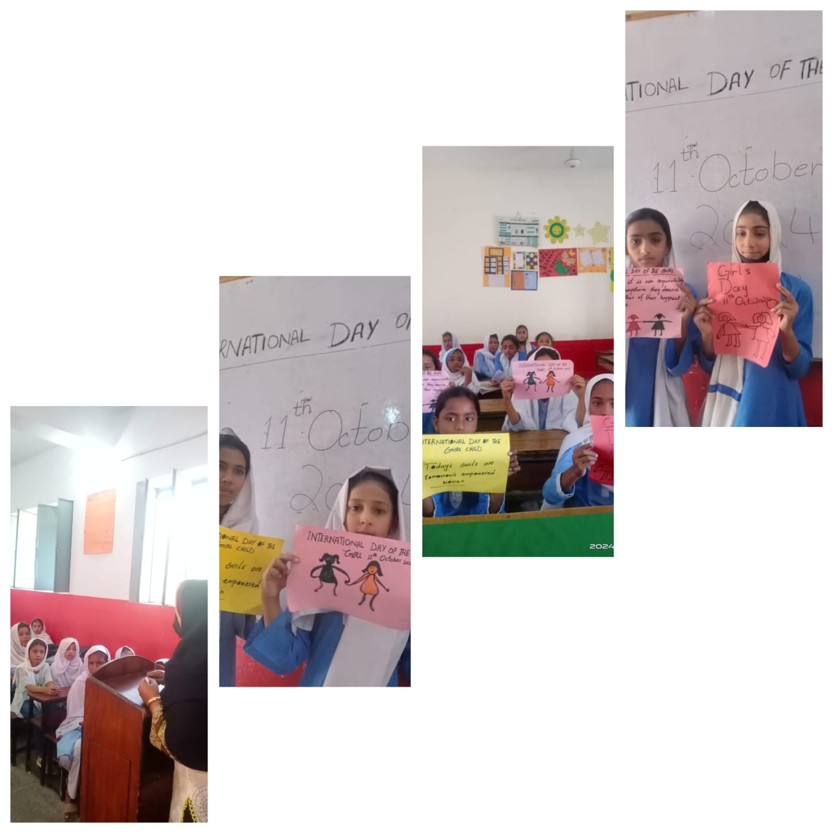
Girls World Day Celebration Chiniot

Slide 33
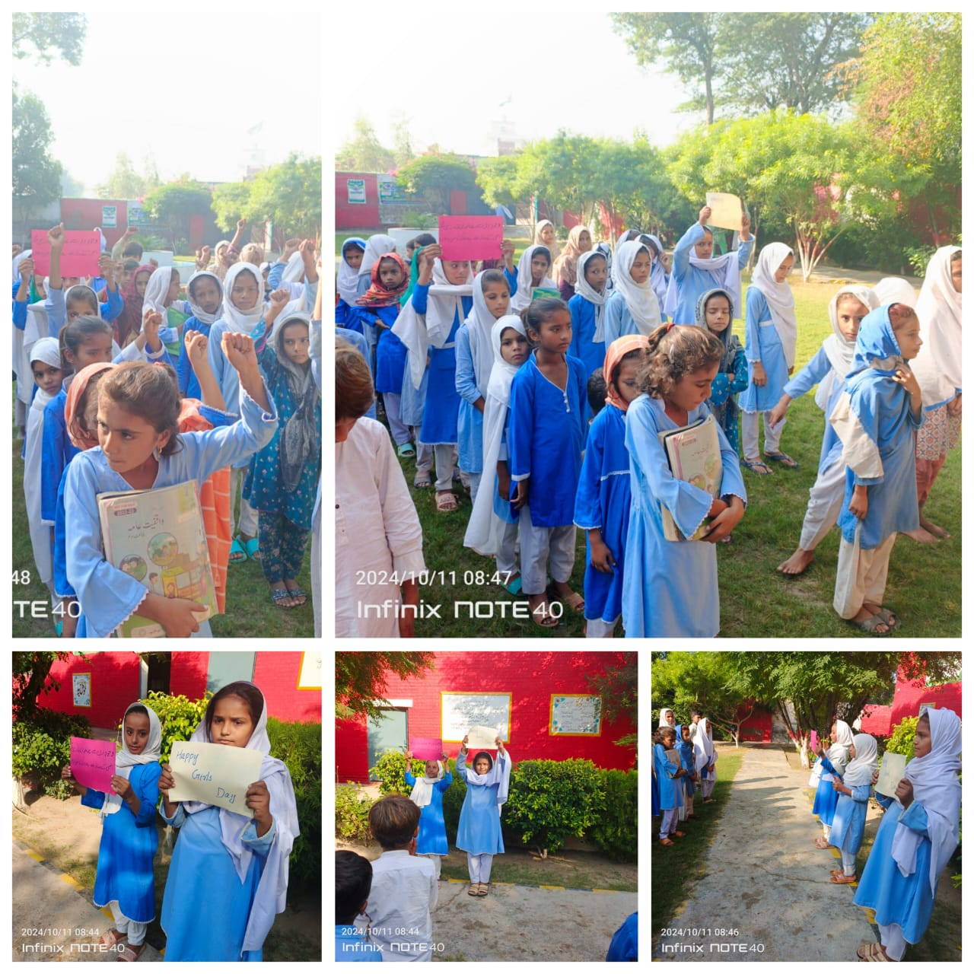
“Girls World Day Celebration Chiniot

Slide 34
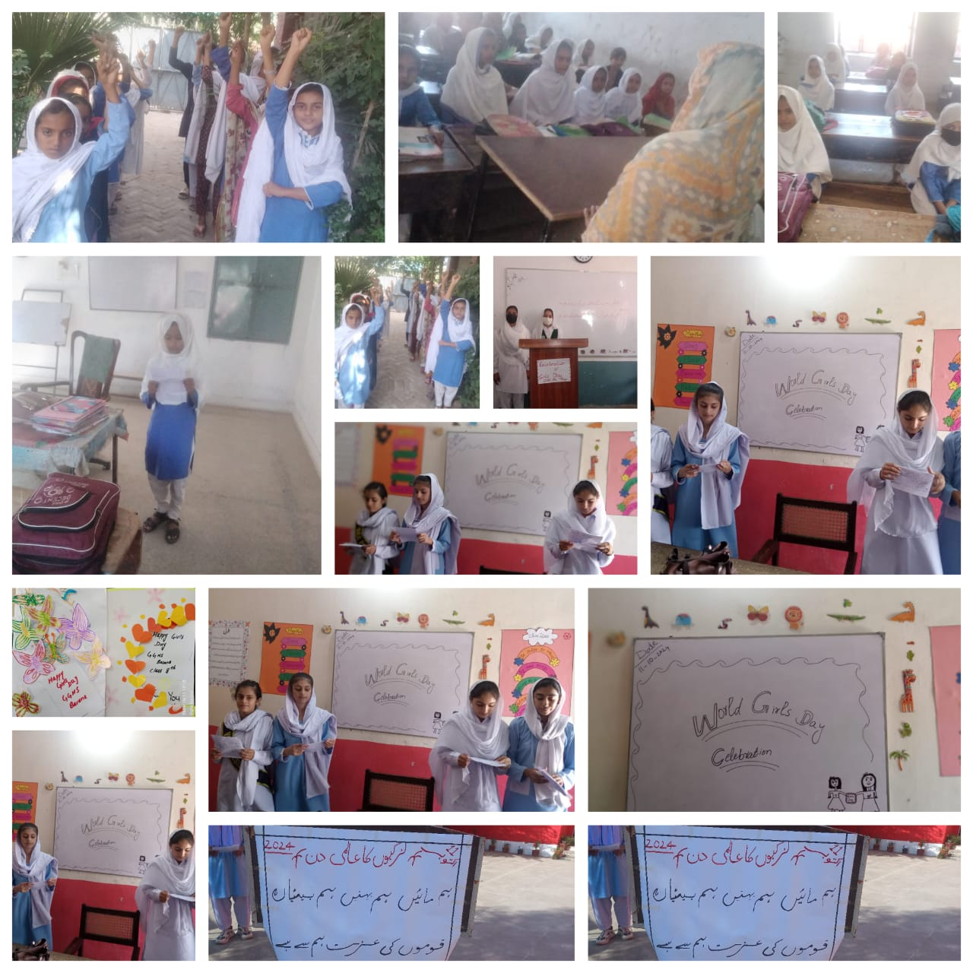
“Girls World Day Celebration Chiniot

Slide 35
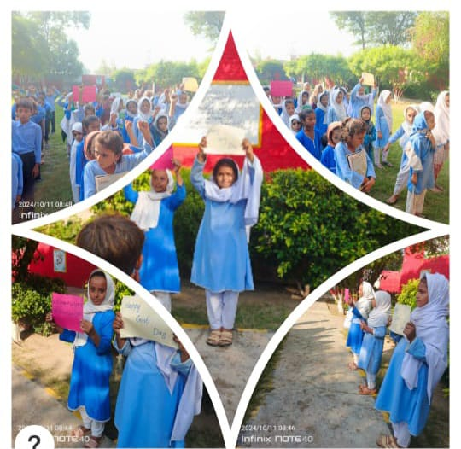
“Girls World Day Celebration Chiniot

Slide 36
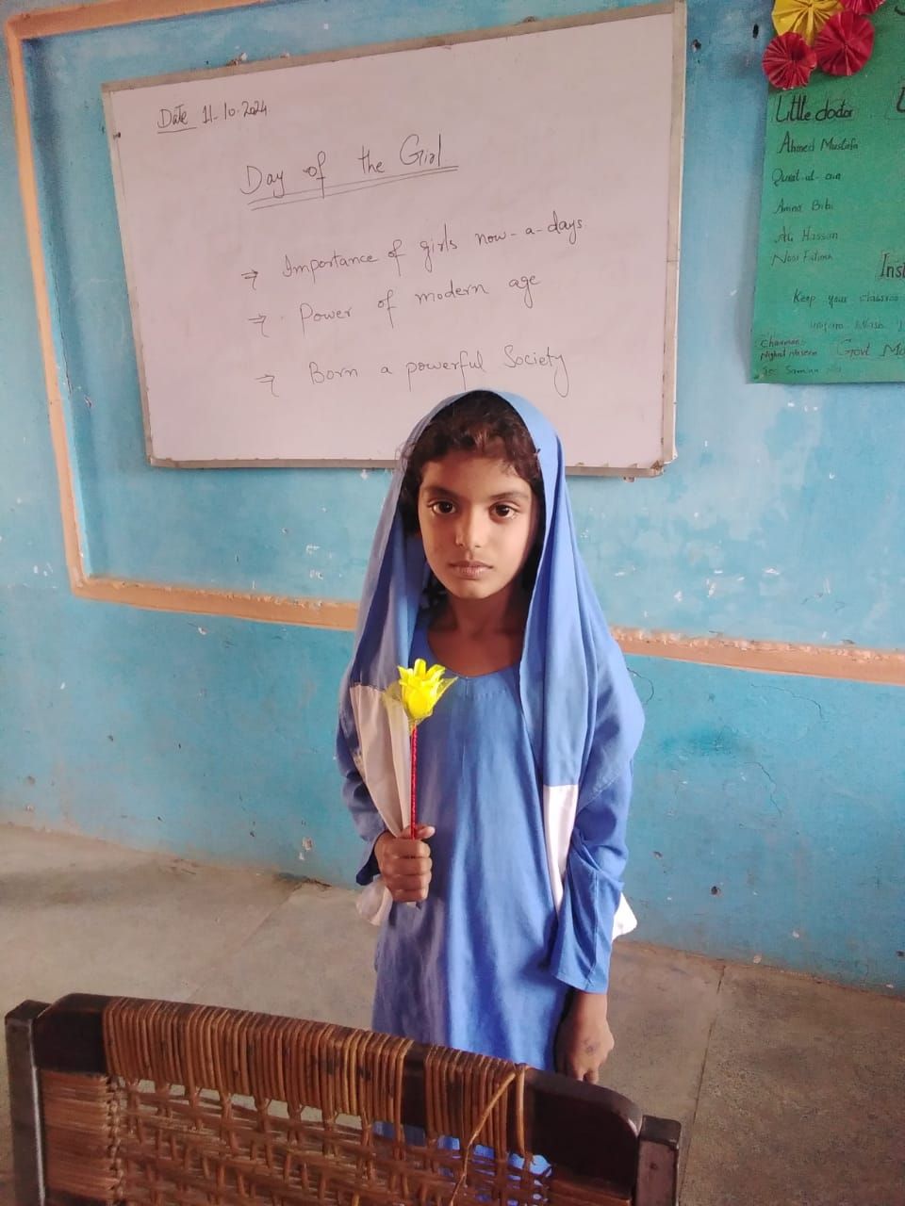
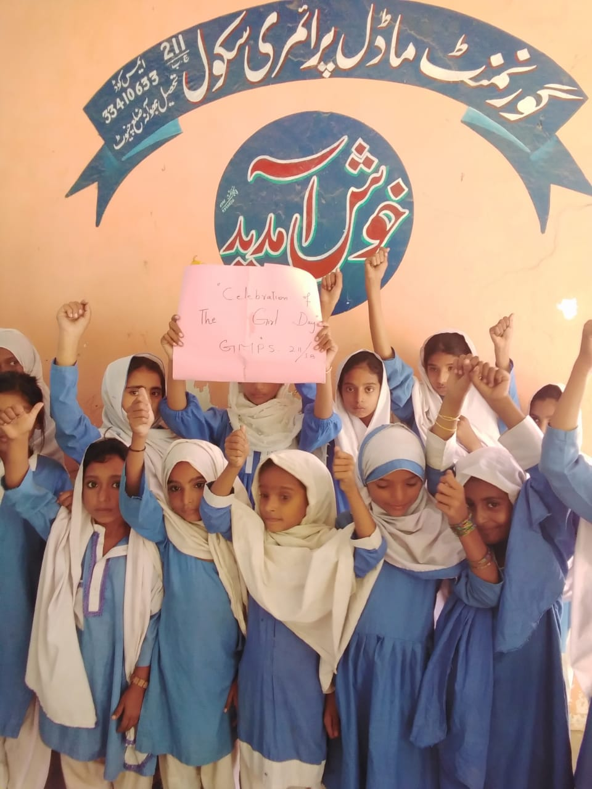
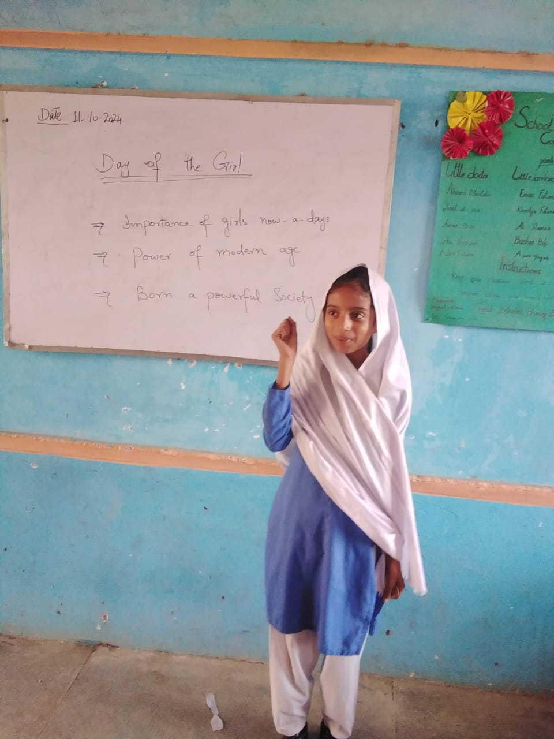
GIRLS DAY CELEBRATION GMPS CHAK NO. 211/JB TEHSIL BHOWANA

Slide 37
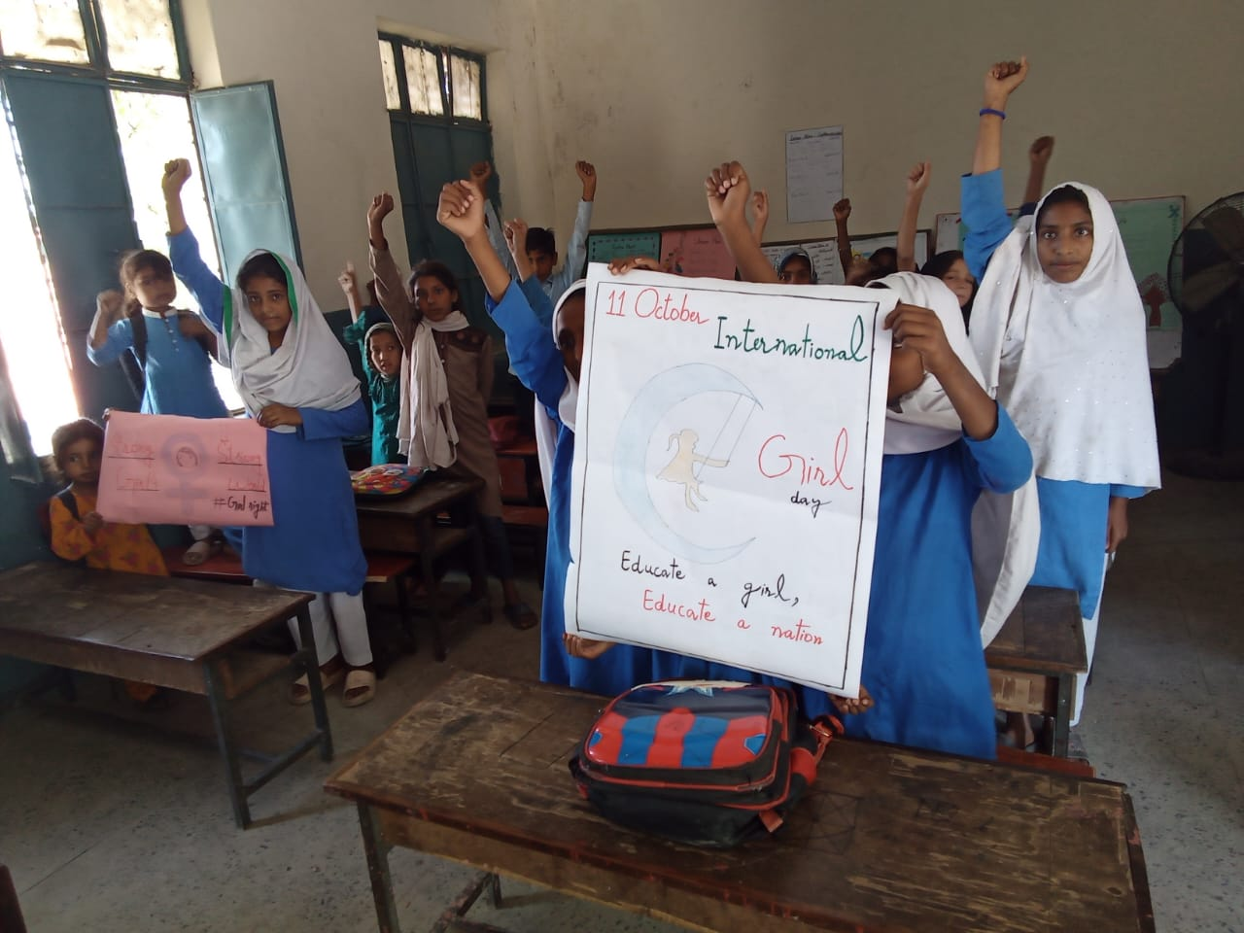
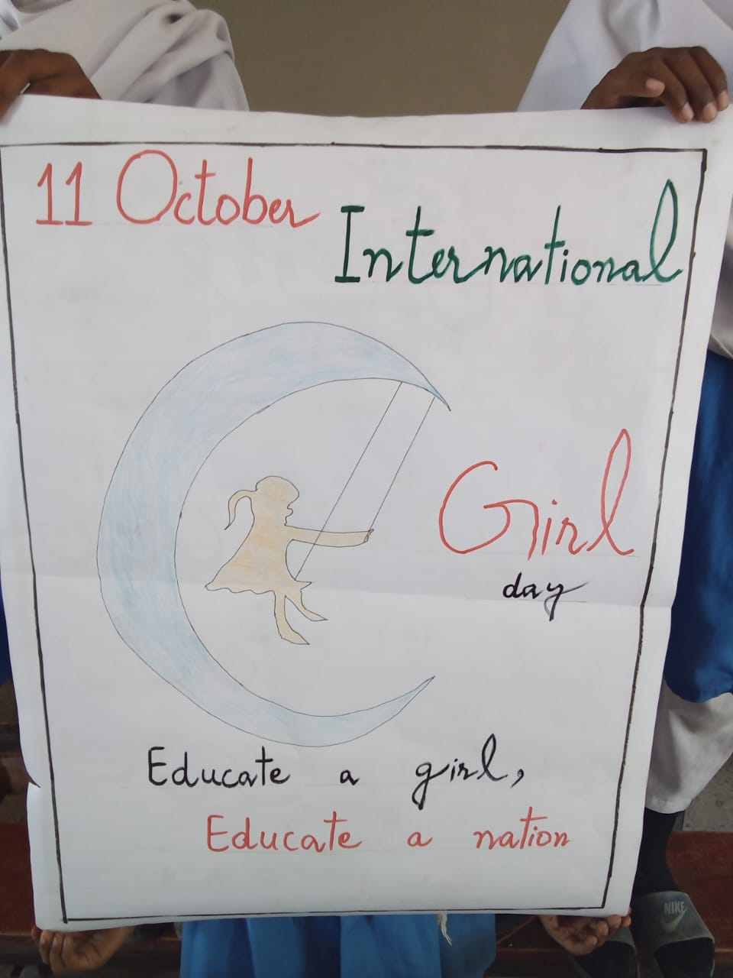
GIRLS DAY CELEBRATION THATHA RAHMOO TEHSIL BHOWANA

Slide 38
GIRLS DAY CELEBRATION GGES CHAK NO. 195/JB TEHSIL BHOWANA

Slide 39
GIRLS DAY CELEBRATION GMES SATIANA SAHMAL TEHSIL BHOWANA

Slide 40
THANK YOU

