Slide 1
Salam Teachers Day 05/10/2024
DISTRICT CHINIOT

Slide 2
DISTRICT - CHINIOT

Slide 3
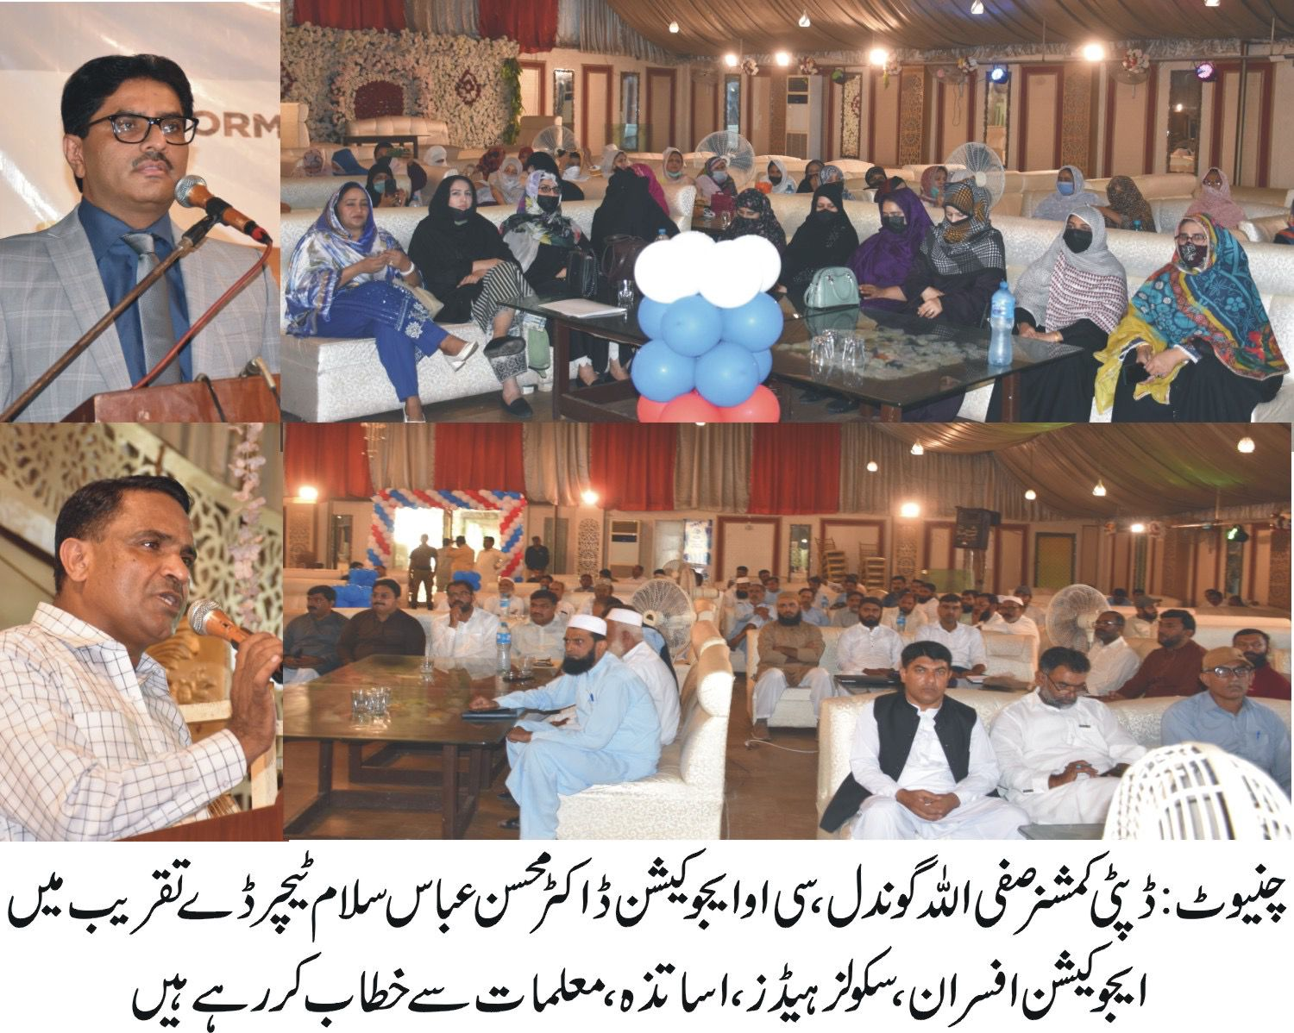
“Hero Award” Ceremony Chiniot

Slide 4
“Hero Award” Salam Teacher's Day Ceremony Chiniot

Slide 5
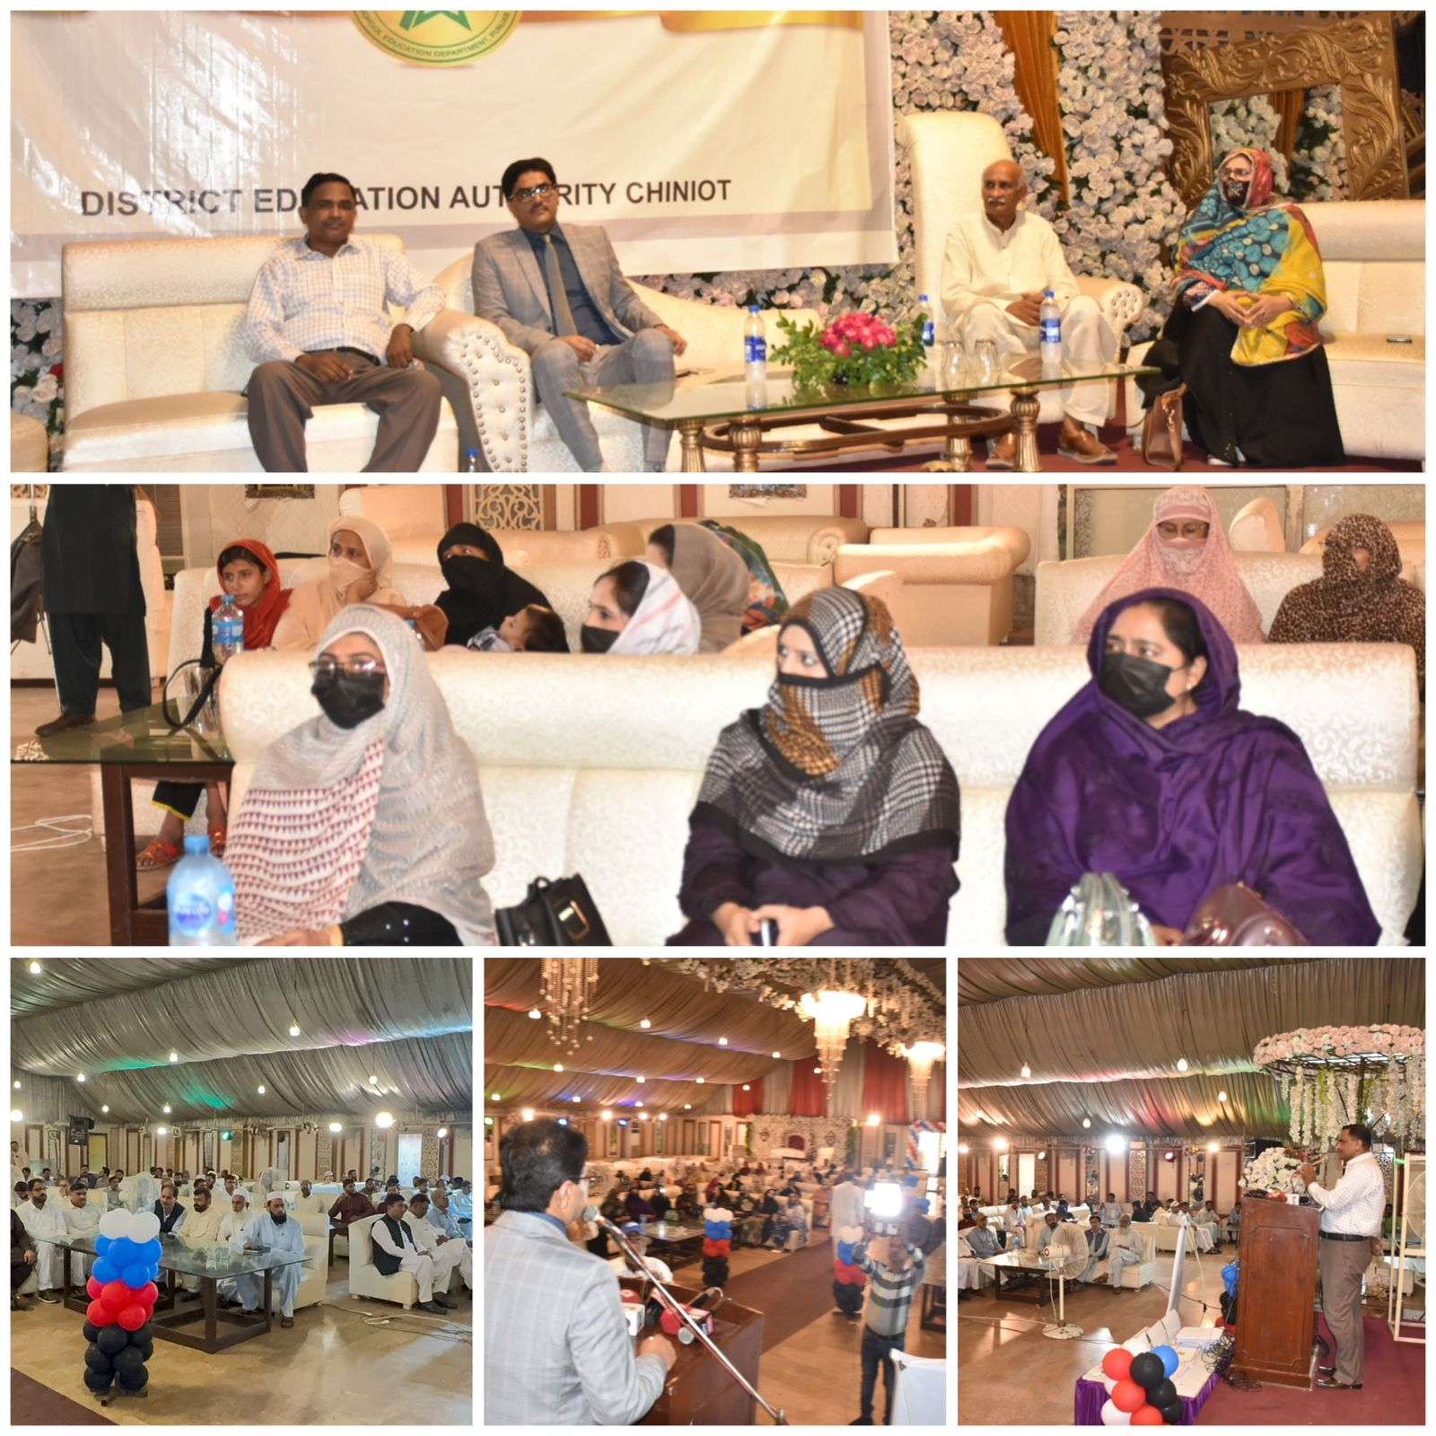
Salam Teacher's Day Ceremony Chiniot

Slide 6
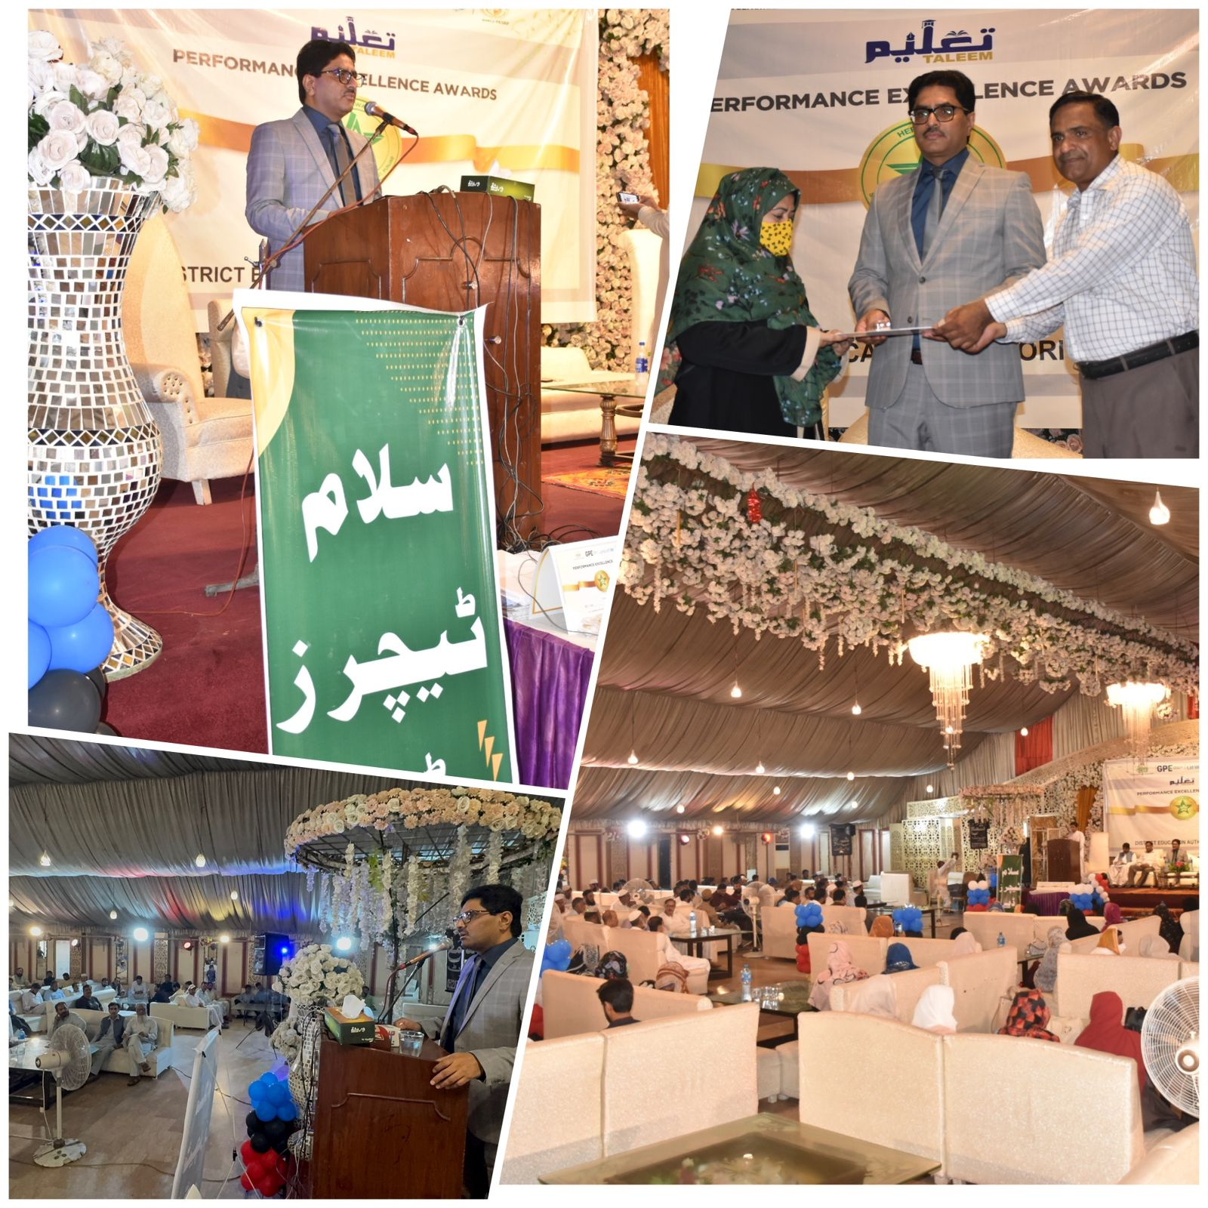
Salam Teacher's day Ceremony Chiniot

Slide 7
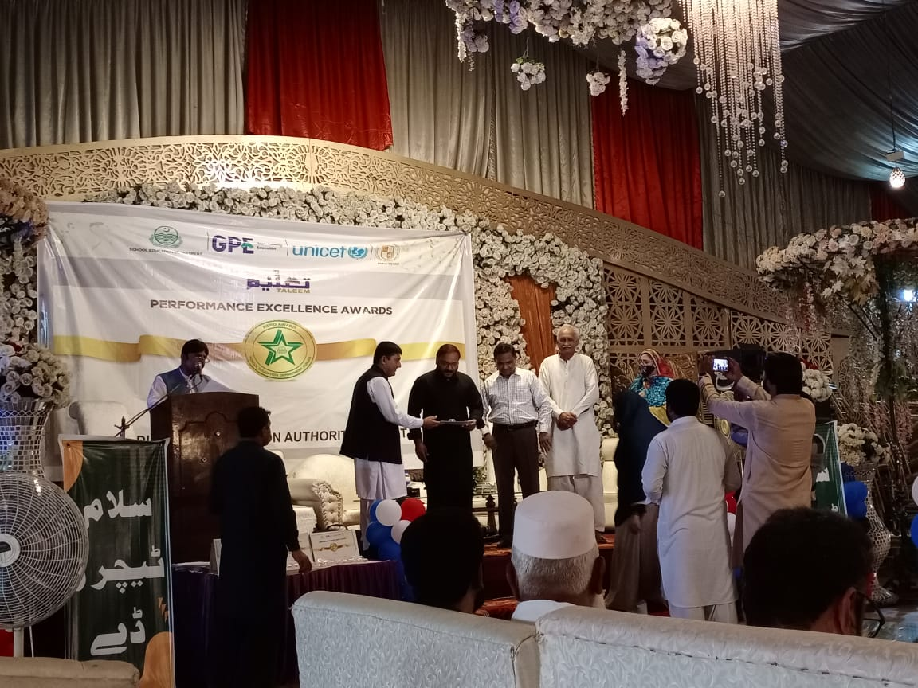
“Hero Award” Ceremony Chiniot

Slide 8
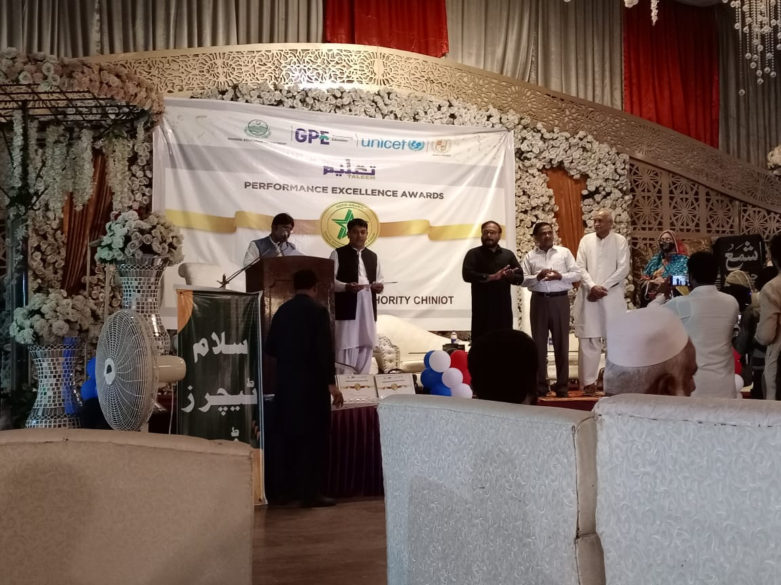
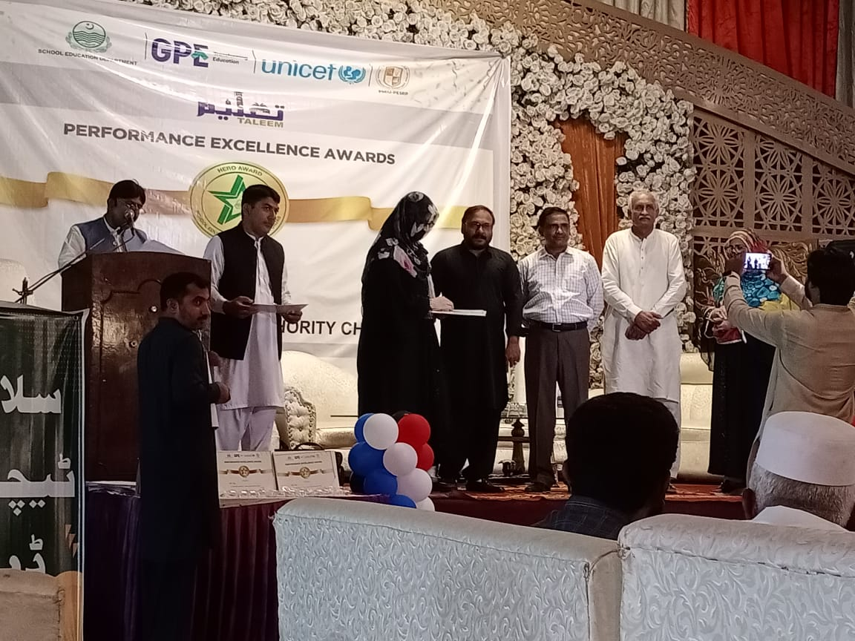
“Hero Award” Ceremony Chiniot

Slide 9
“Hero Award” Salam Teacher's Day Ceremony Chiniot

Slide 10
“Hero Award” Salam Teacher's Day Ceremony Chiniot

Slide 11
“Hero Award” Salam Teacher's Day Ceremony Chiniot

Slide 12
“Hero Award” Salam Teacher's Day Ceremony Chiniot

Slide 13
“Hero Award” Salam Teacher's Day Ceremony Chiniot

Slide 14
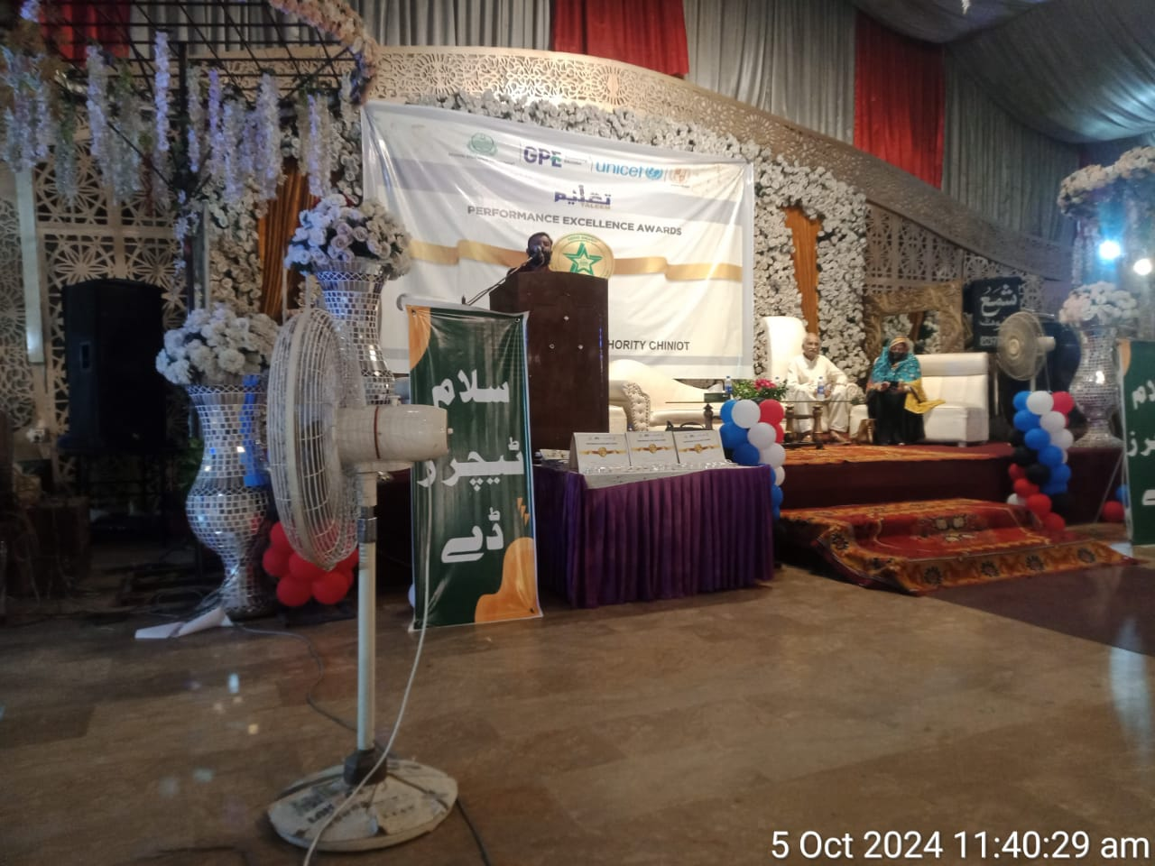
“Hero Award” Salam Teacher's Day Ceremony Chiniot

Slide 15
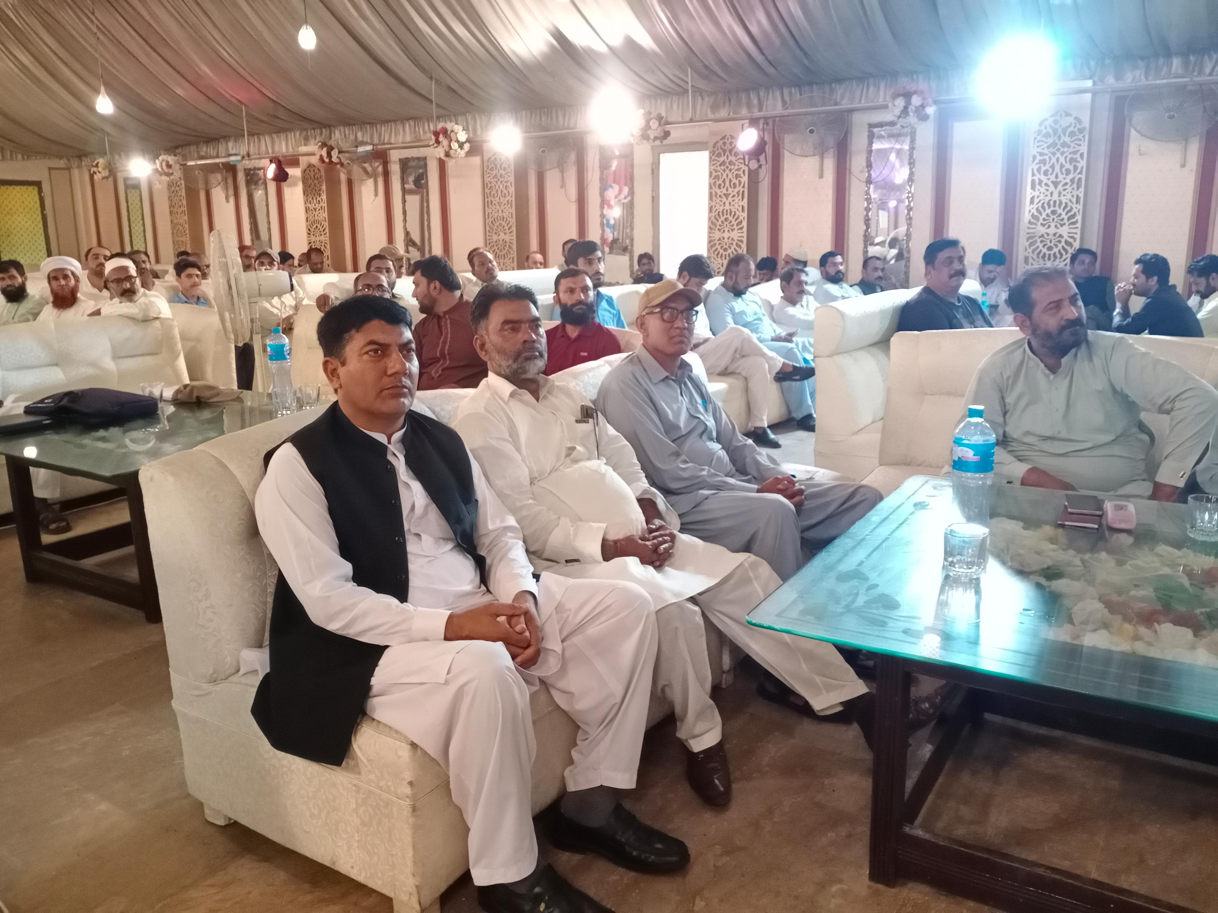
“Hero Award” Salam Teacher's Day Ceremony Chiniot

Slide 16
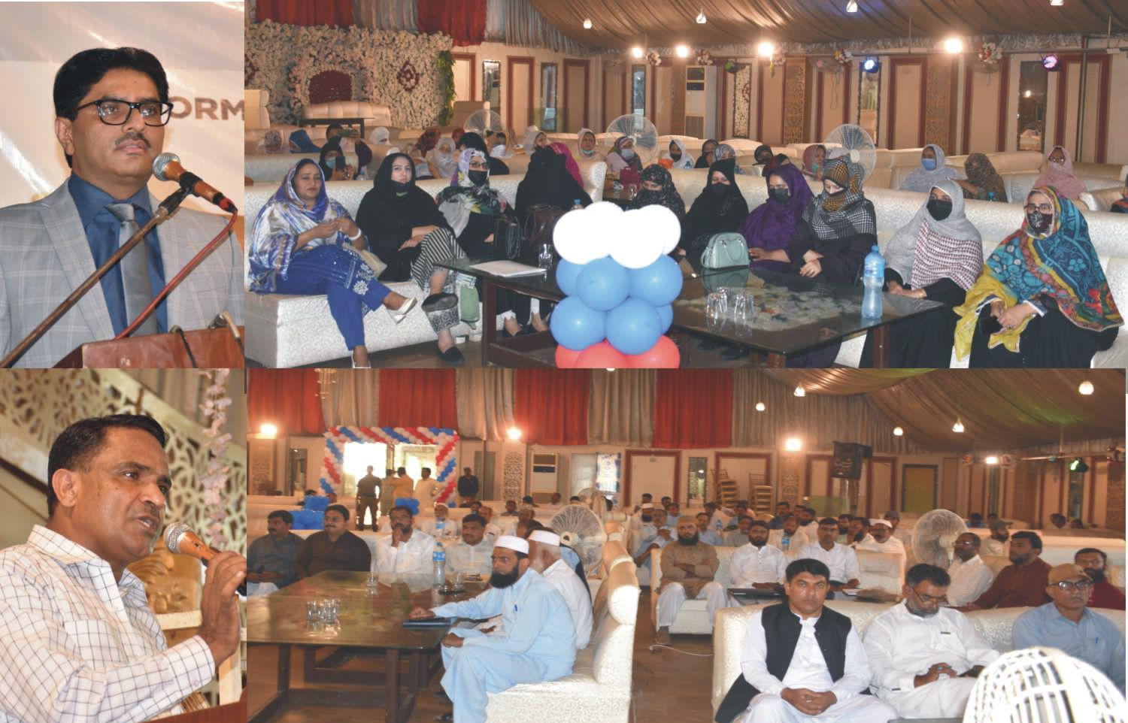
“Hero Award” Salam Teacher's Day Ceremony Chiniot

Slide 17
THANK YOU

